Slide 1
Managing Supply Chain Disruption:
A Battery Perspective
February 18, 2022
Bob Galyen
SAE Fellow and Chairman Battery Standards Steering Committee
Chairman Emeritus/CTO NAATBatt International

Slide 2
Short Abstract:
Lithium-Ion Battery technology is taking over the energy storage role in this century within mobility and grid sectors, moving rapidly to take over from petroleum-based fuels responsible for carbon pollutants from combustion processes. However, we as an industry in the USA are recognizing that supply chain is quite deficient in many areas. The biggest supply chain disruptor for batteries? The raw materials are almost non-existent in the USA.

Slide 3

A Historical Perspective of the Present Electrification Era as it relates to Supply Chain for Batteries

Slide 4
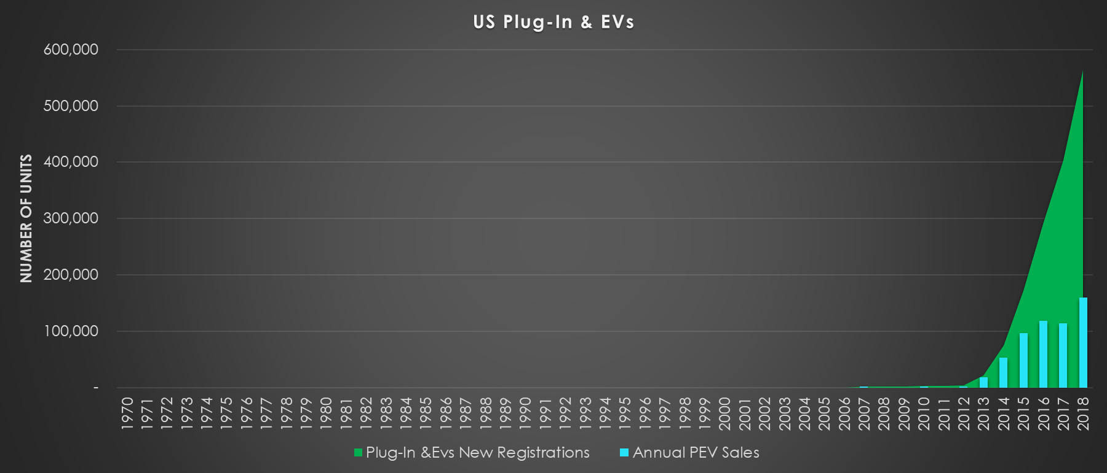




Adoption of LIB’s…..How Long?
~16 Years
~18 Years
8 Years
13 Years
R&D
Goodenough
1st Commercial Li-ion
1st High Volume EV
Electrification: Lab to Widespread Adoption
Source: Dr. John Warner, 2018

Slide 5
Adoption of Liquidous State LIB’s: How Mature?
Awareness
Trial
& Early
Adopters
Mass Market
Saturation
Adoption Rate
Worldwide in 2022
15%
10%
5%
2 ½%
Time
Source: Dr. John Warner, 2018

Slide 6
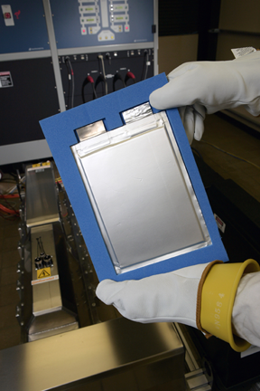
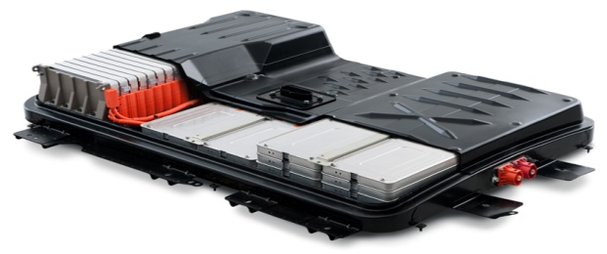
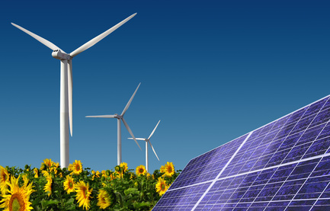
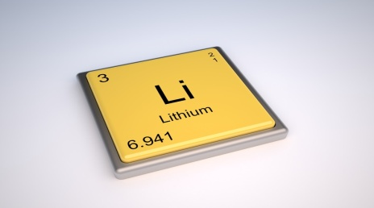
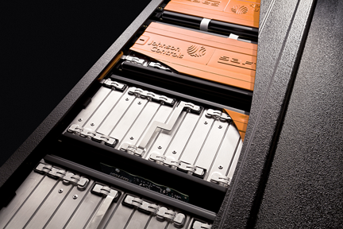
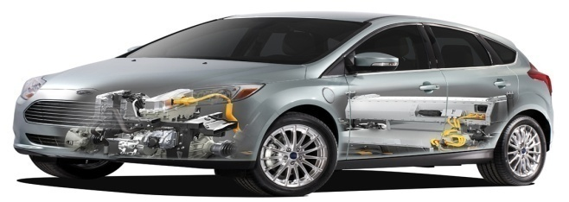
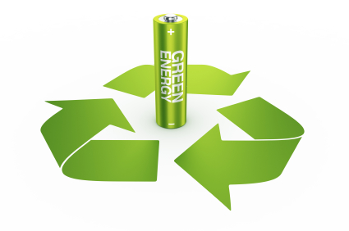
How Does Supply
Affect Value Chain?
Raw
Materials
Modules
Applications
Recycle
Supply Across All Aspects of the Value Chain
Cells
Packs
2nd Use
INFRASTRUCTURE

Slide 7

Business in this Decade of the 2020’s

Slide 8
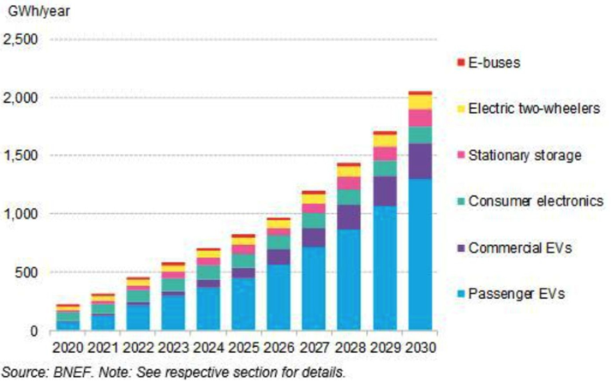
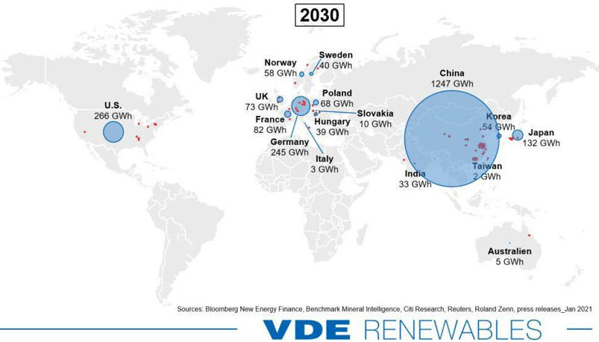
Demand and Supply Growth: Regions of the World
Huge Demand Growth Drives Terawatt Level Supply
BNEF

Slide 9
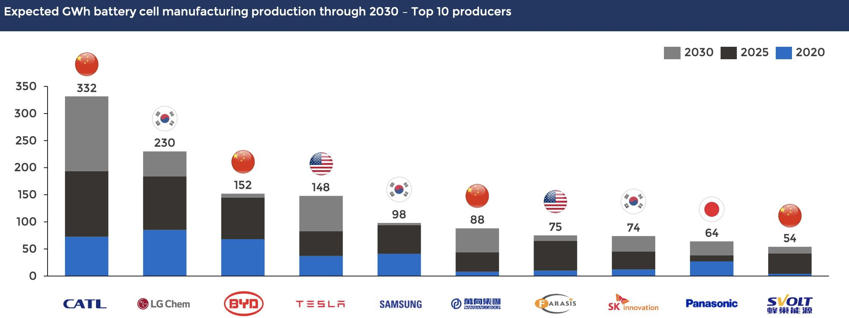

Global Planned Capacity of Top Manufacturers for Liquidous State Lithium-Ion Batteries
Planned manufacturing capacity exceeds 2.4 TWh within a decade
*Source: BENCHMARK MINERAL INTELLIGENCE

Slide 10
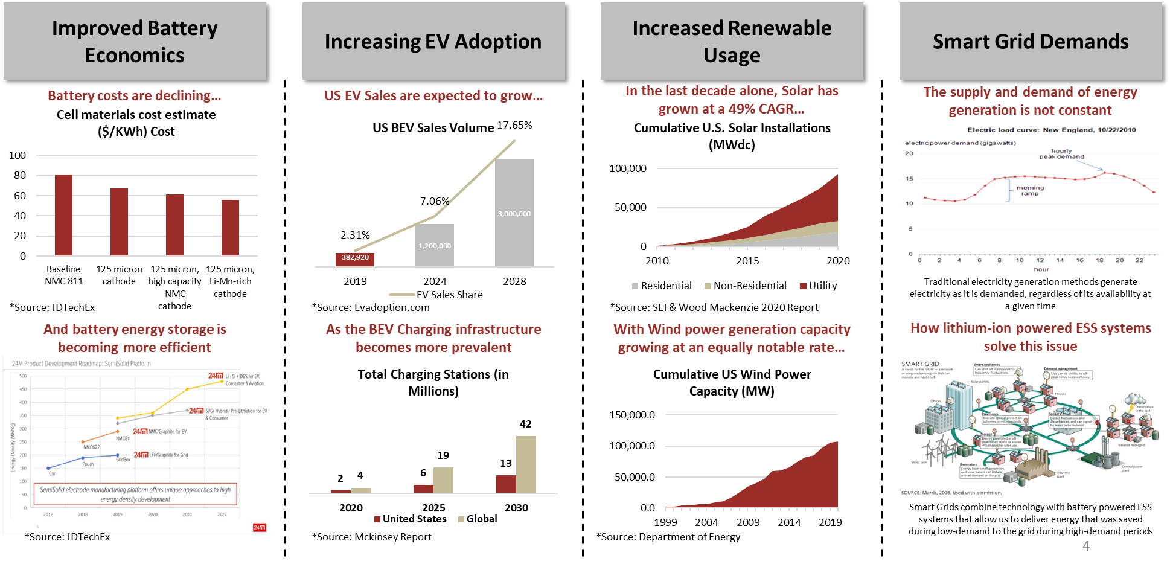
What are the Megatrends for the Battery Market?

Slide 11

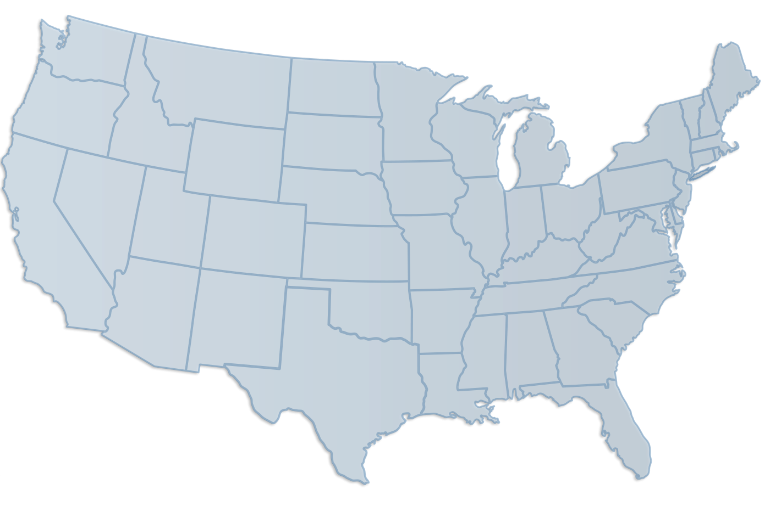
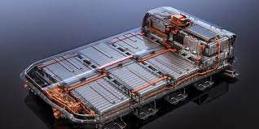











Massive Cell Production Planned for the US to Address EV Demand
400GWh Announced Cell Capacity by 2025 (equivalent to 4 – 5 million vehicles)
Stated capacity by location / program
Site not yet announced
GWh
5
40
23
35
Others DoD,
Others
DoD,
Others
35
www.6kinc.com
10
6
39
70
Small Plants (<3GWh per plant)
20
12
21
129
3
> $125B Investment in process for US EV and Cell Production

Slide 12

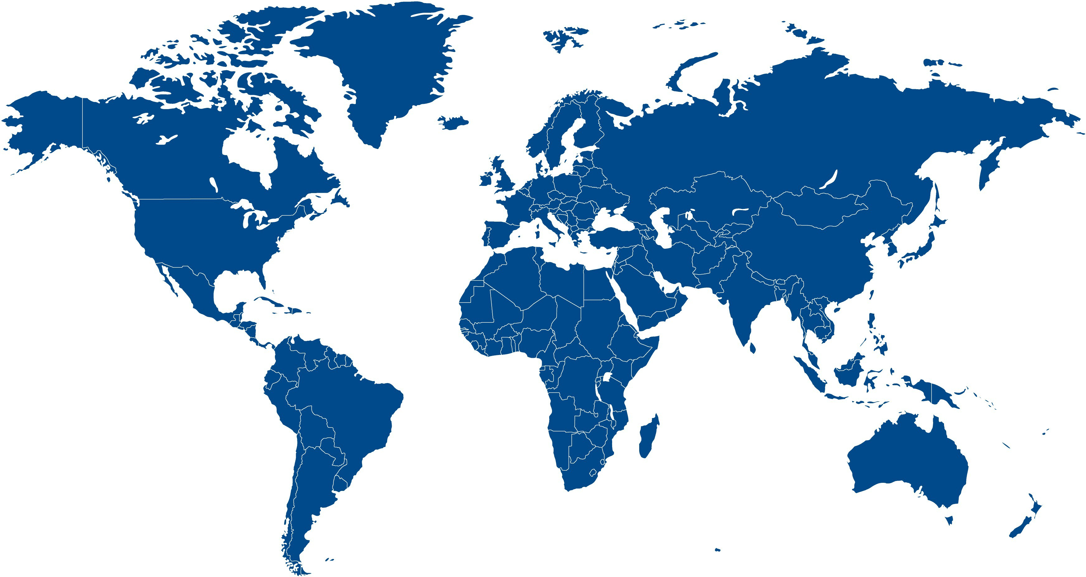
















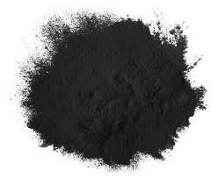
Where Do Battery Materials Come From Today?
China completely dominates global cathode (battery material) production
UK – ~0%
EU – 4%
China – 85%
US – ~0%
Korea – 8%
Japan – 2%
Source - BNEF
The US is entirely dependent on a fragile supply chain from an economic rival
7

Slide 13


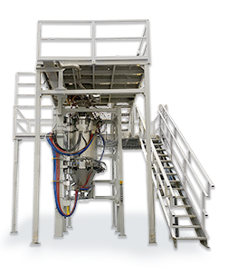

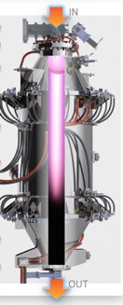



6K’s Transformational Technology supports US production CHEAPER than China
6K collapses the production process time by 95% resulting in a 50%-60% reduction in conversion cost… EVEN IN THE US
Cathode Production Process Traditional chemistry vs. 6K
Cathode Production Costs – Single XTL NMC811 Traditional chemistry vs. 6K
Traditional
UniMelt
Starting material, no Li
Starting material Includes Li
$/kg
CoGS Minus Yielded BOM
$NDA
(US)
$7.00
20%+ premium if made in US
Add Dropwise & Stir
Dissolve & Stir
8
7
6
5
4
3
2
1
0
10+ Step Process
Precipitation
Filter Wash and dry
Sieving
Mix add Lithium Calcination – 10+ HRS Flux and Heat Treat
3 Step Process
h o u r s
-50%
d a y s
s t e p s
Plasma Processing 2-3 sec
3
3 s t e p s
-62%
1 - 3
1 0 - 1 5
$2.26
Wash and dry
Heat treat - <3 HRS*
GEN 1
GEN 2
Today
Co-Precipitation
NMC Powder
NMC Powder
Today
Amastan
2 – 3 Days
1– 3 Hours
*for single crystal NMC.
* with 3hr calcination
Cost will ultimately win, which requires things to be done differently

Slide 14

NAATBatt International Creates Supply Chain Database

Slide 15
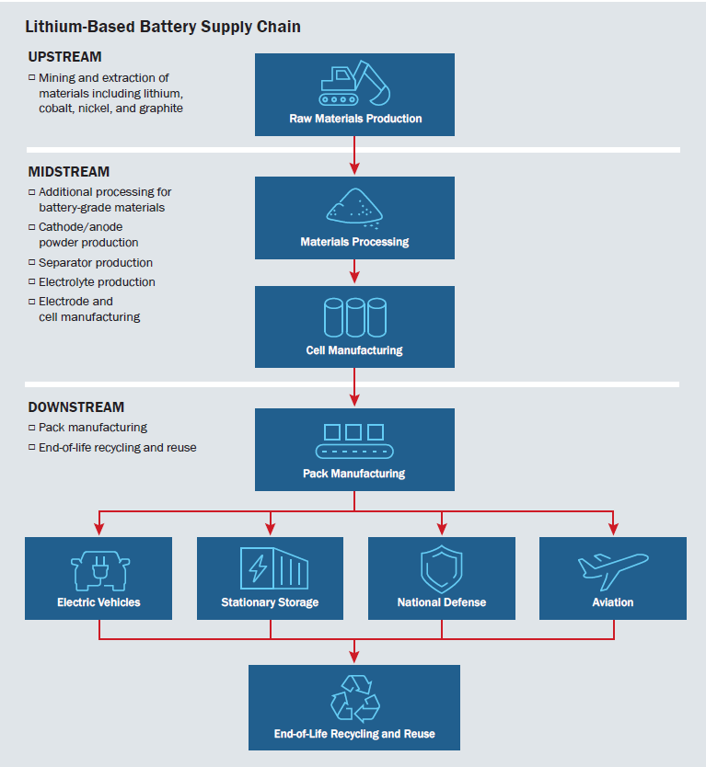
Supply Chain Segments in the Database
FCAB National Blueprint for Batteries 2021-2030
Manufacturing Supply Chain
  Raw Materials
  Battery Grade Materials
  Other Battery Components and Materials
  Electrode and Cell Manufacturing
  Module/Pack Manufacturing
EOL Supply Chain
Other Segment Supply Chains
  Equipment
  Service
  R&D
  Modeling and Software
  Distributors
Database Sheets
Raw Materials
Battery Grade Materials
Other Battery Components and Materials
Electrode and Cell Manufacturing
Module/Pack Manuf.
EOL

Slide 16
Current Database Statistics
*Companies are counted more than once if they are active in multiple sections of the supply chain and/or have multiple products

Slide 17
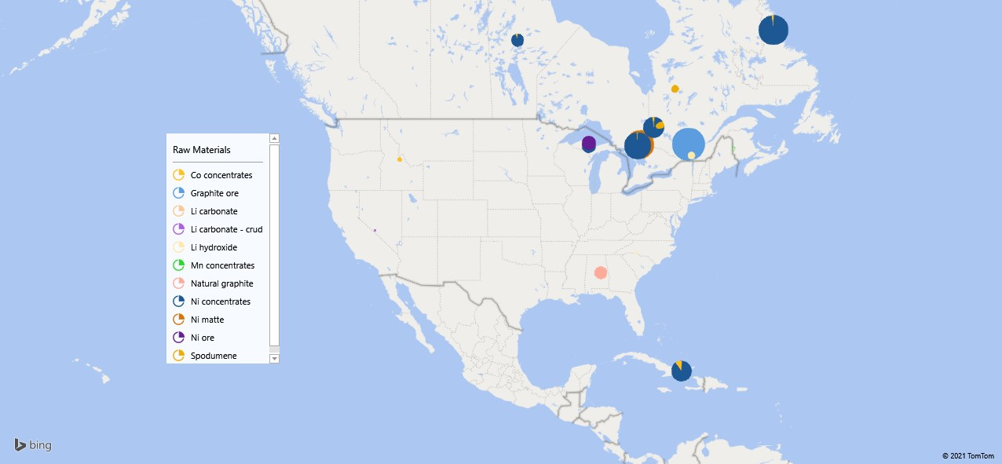
Raw Materials

Slide 18
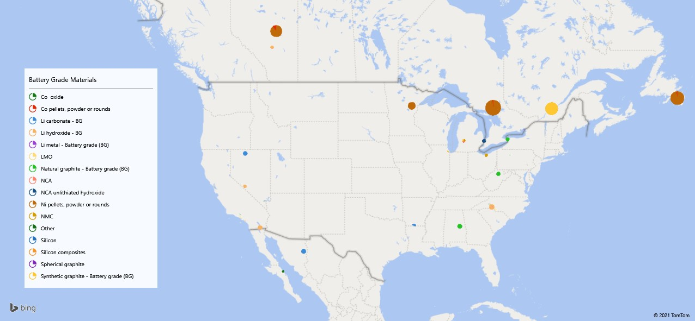
Battery Grade Materials

Slide 19
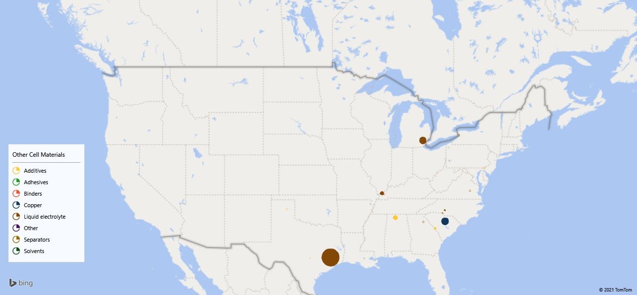
Other Cell Components and Materials

Slide 20
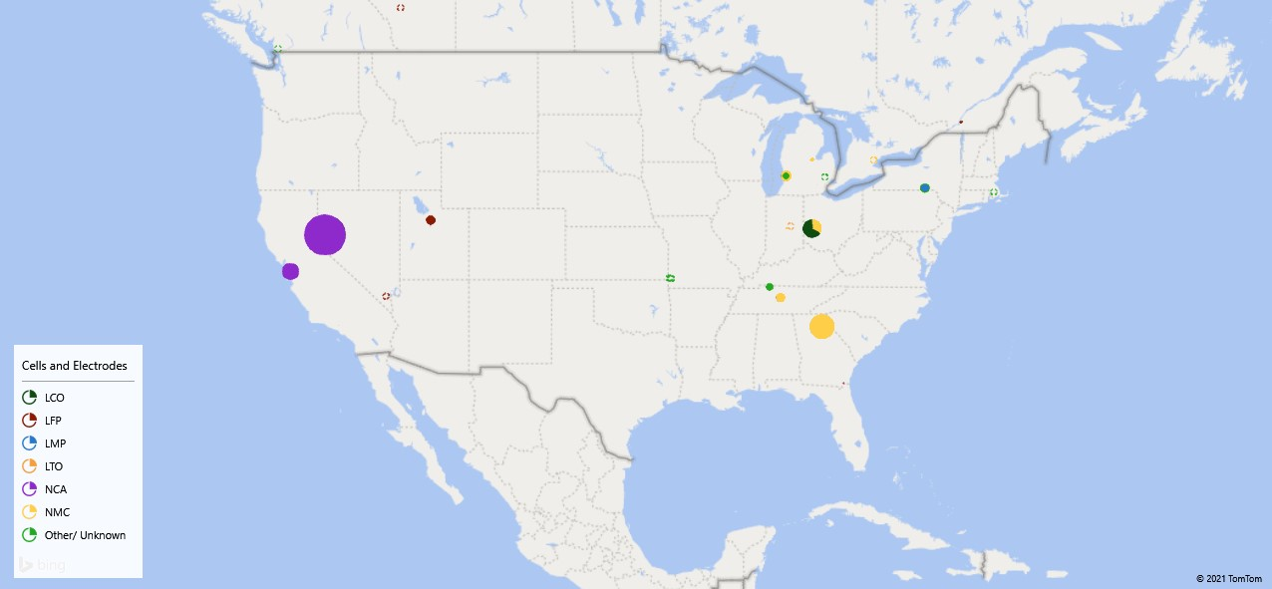
Cells and Electrodes

Slide 21
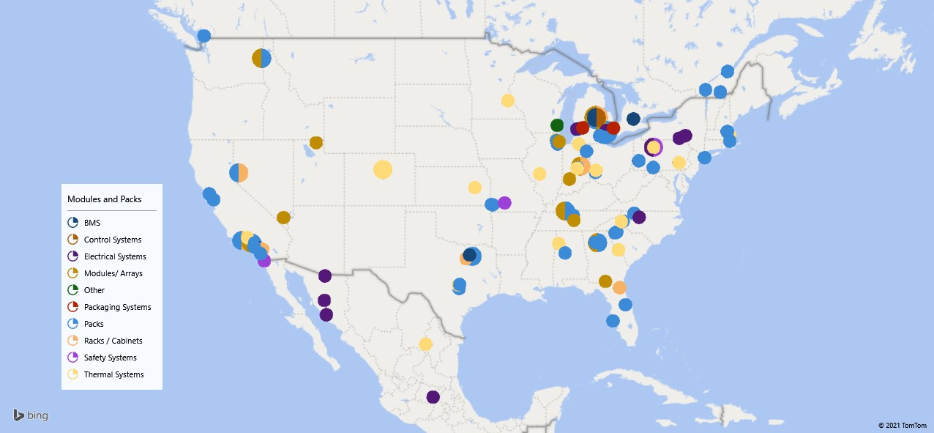
Modules and Packs

Slide 22
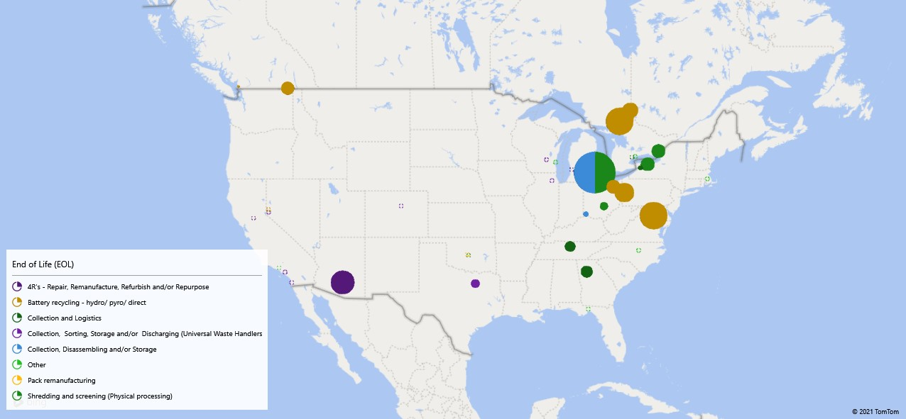
End of Life

Slide 23
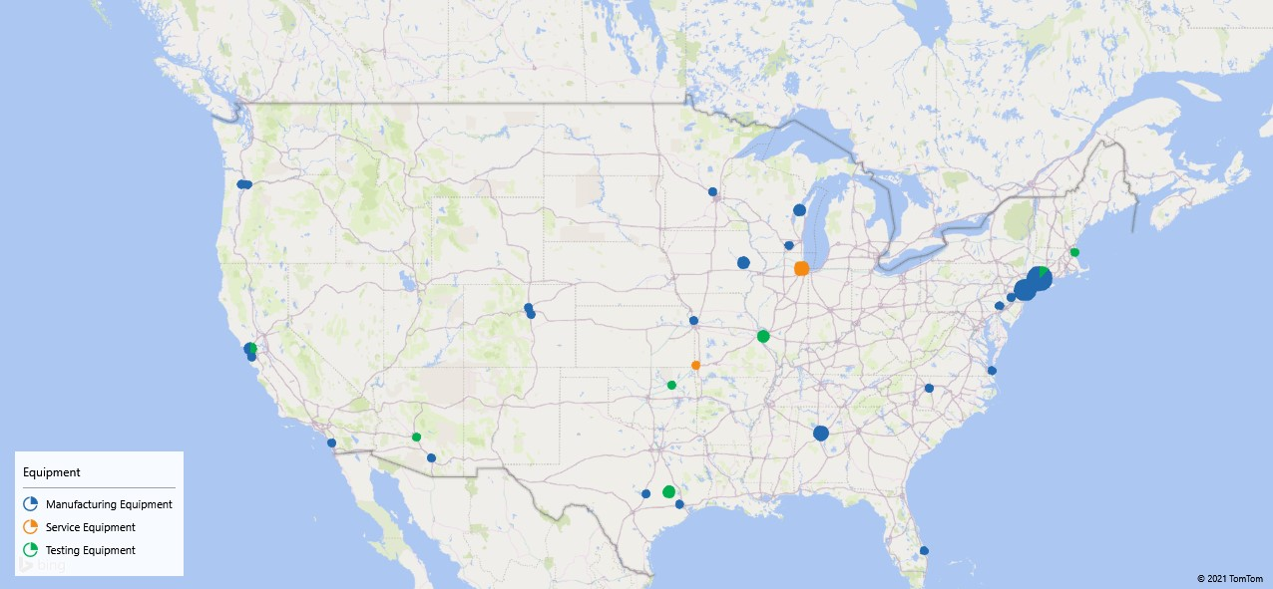
Equipment Manufacturing

Slide 24

Introduction to Li-Bridge
Context
2022 key objectives
Establish a clear strategy for building a domestic supply chain for batteries that is:
Li-Bridge is a public-private partnership tasked with developing a national strategy that creates a sustainable & robust US supply chain for lithium batteries.
Li-Bridge’s scope includes:
Lithium-based batteries
All applications
Full value chain
Both supply and demand policy levers
Competitively advantaged
Economically sustainable
Environmentally sustainable
Resilient
Leverages the best of the US's public and private companies, institutions, and networks
Copyr ight © 2019 by Boston Consulting Gr oup. All r ights r eserved.
Argonne National Labs serves as facilitator between private industry & the federal agencies and Departments
Private industry participation is facilitated by an alliance of NAATBatt, NY-BEST, and New Energy Nexus.
1

Slide 25
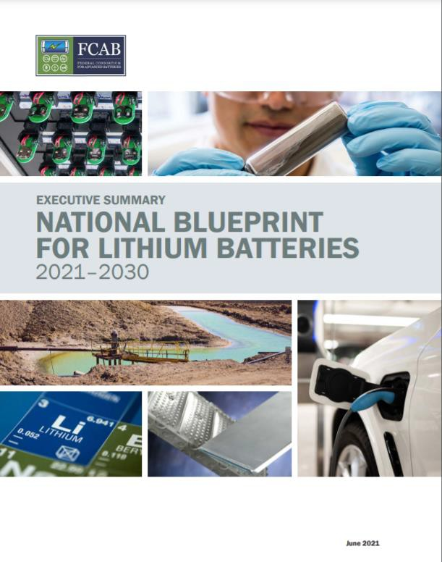
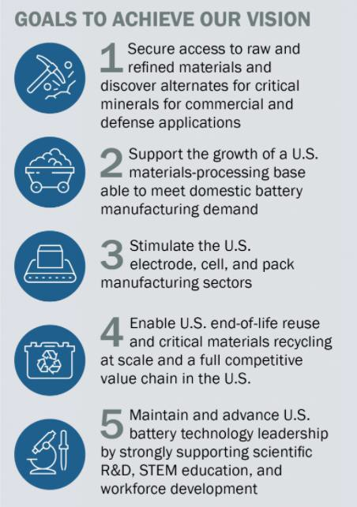
Last year's Blueprint the starting point; Li-Bridge to inform priorities
Achieving the lofty targets of the National Blueprint for Lithium Batteries will require alignment between the federal government, private industry and research institutions…
The Li-Bridge alliance will bring these pieces into a cohesive whole.
— Venkat Srinivasan,
ACCESS director and deputy
director, JCESR

Slide 26
Six topic committees to be established and to develop the strategy
National competitiveness (GDP, jobs, security of supply)
Innovation
Industrialization
Localization
1
Technology, Innovation & Transparency
2
Demand, Supply & Availability
3
Economic Competitiveness & Differentiation
4
Manufacturing & Infrastructure
5
Workforce & Communities
6
Li-Bridge Go-Forward Operating Model

Slide 27


Forums to be completed by end of July
Activity
Feb Mar Apr May Jun Jul Aug Sep Oct Nov
Launch PMO
Perform analysis
Forums
Overall synthesis & packaging
Whitepaper & socialization

Slide 28

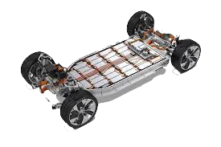

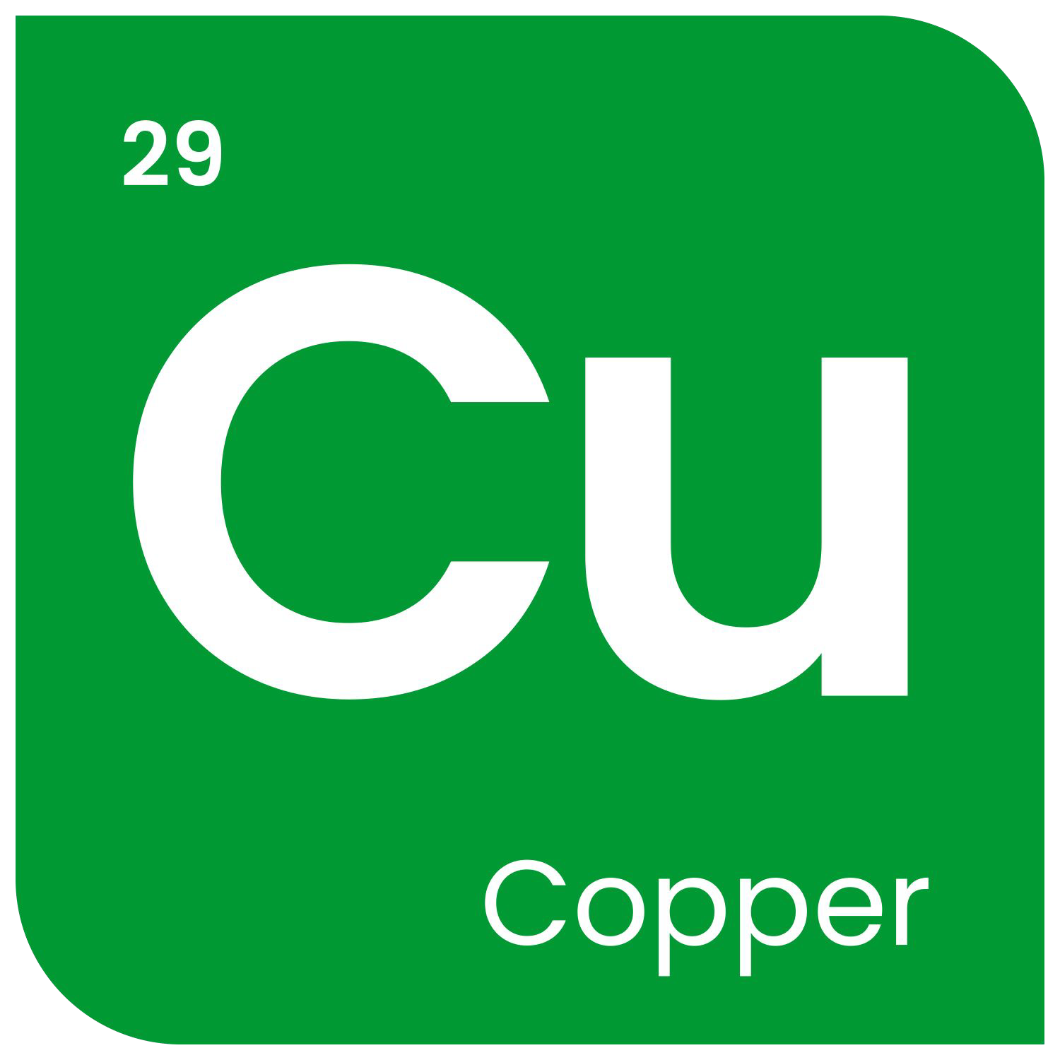
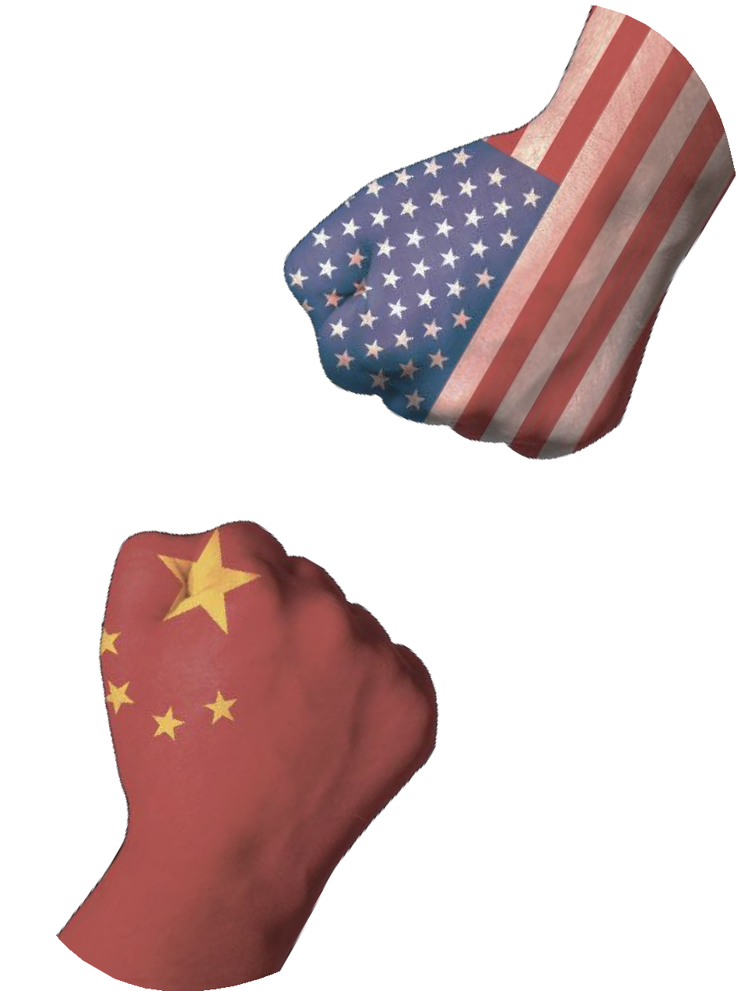
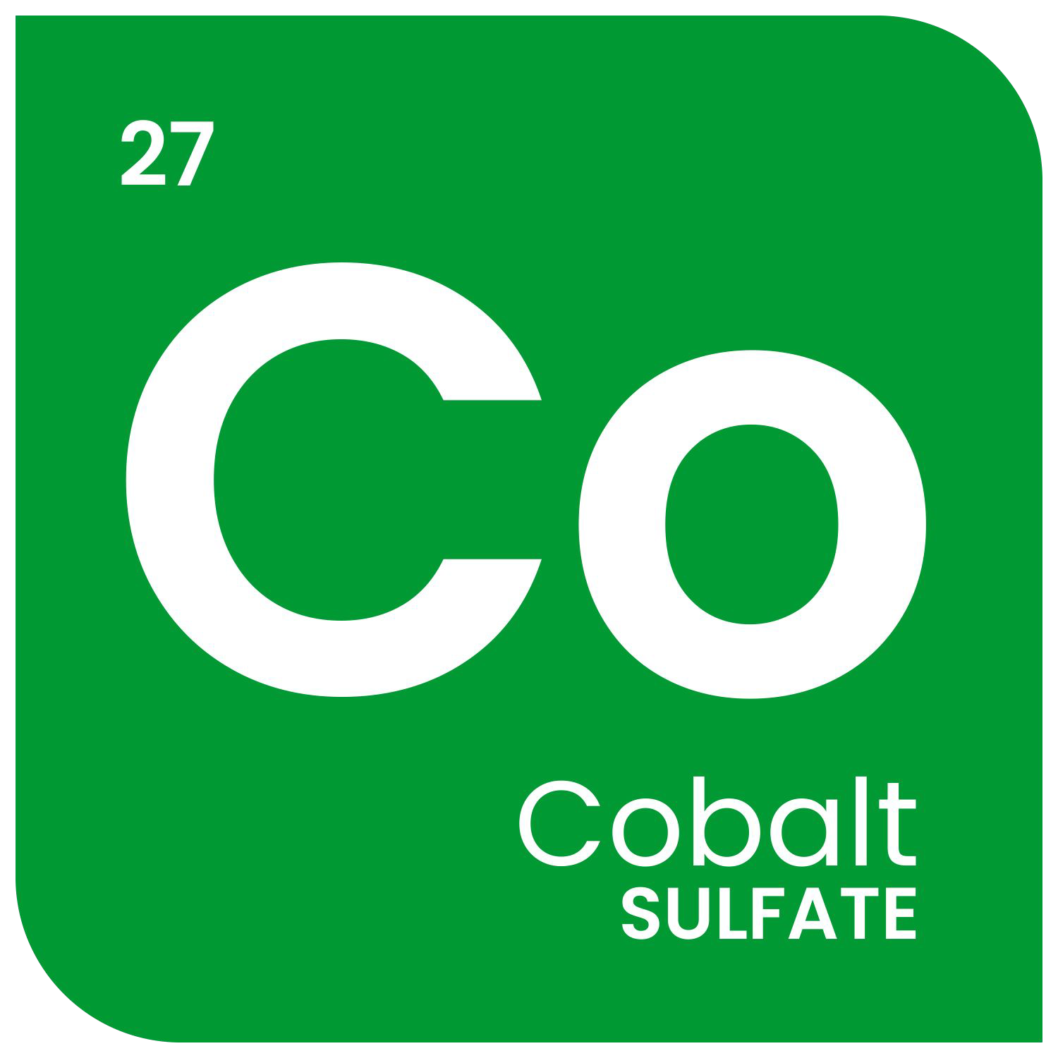
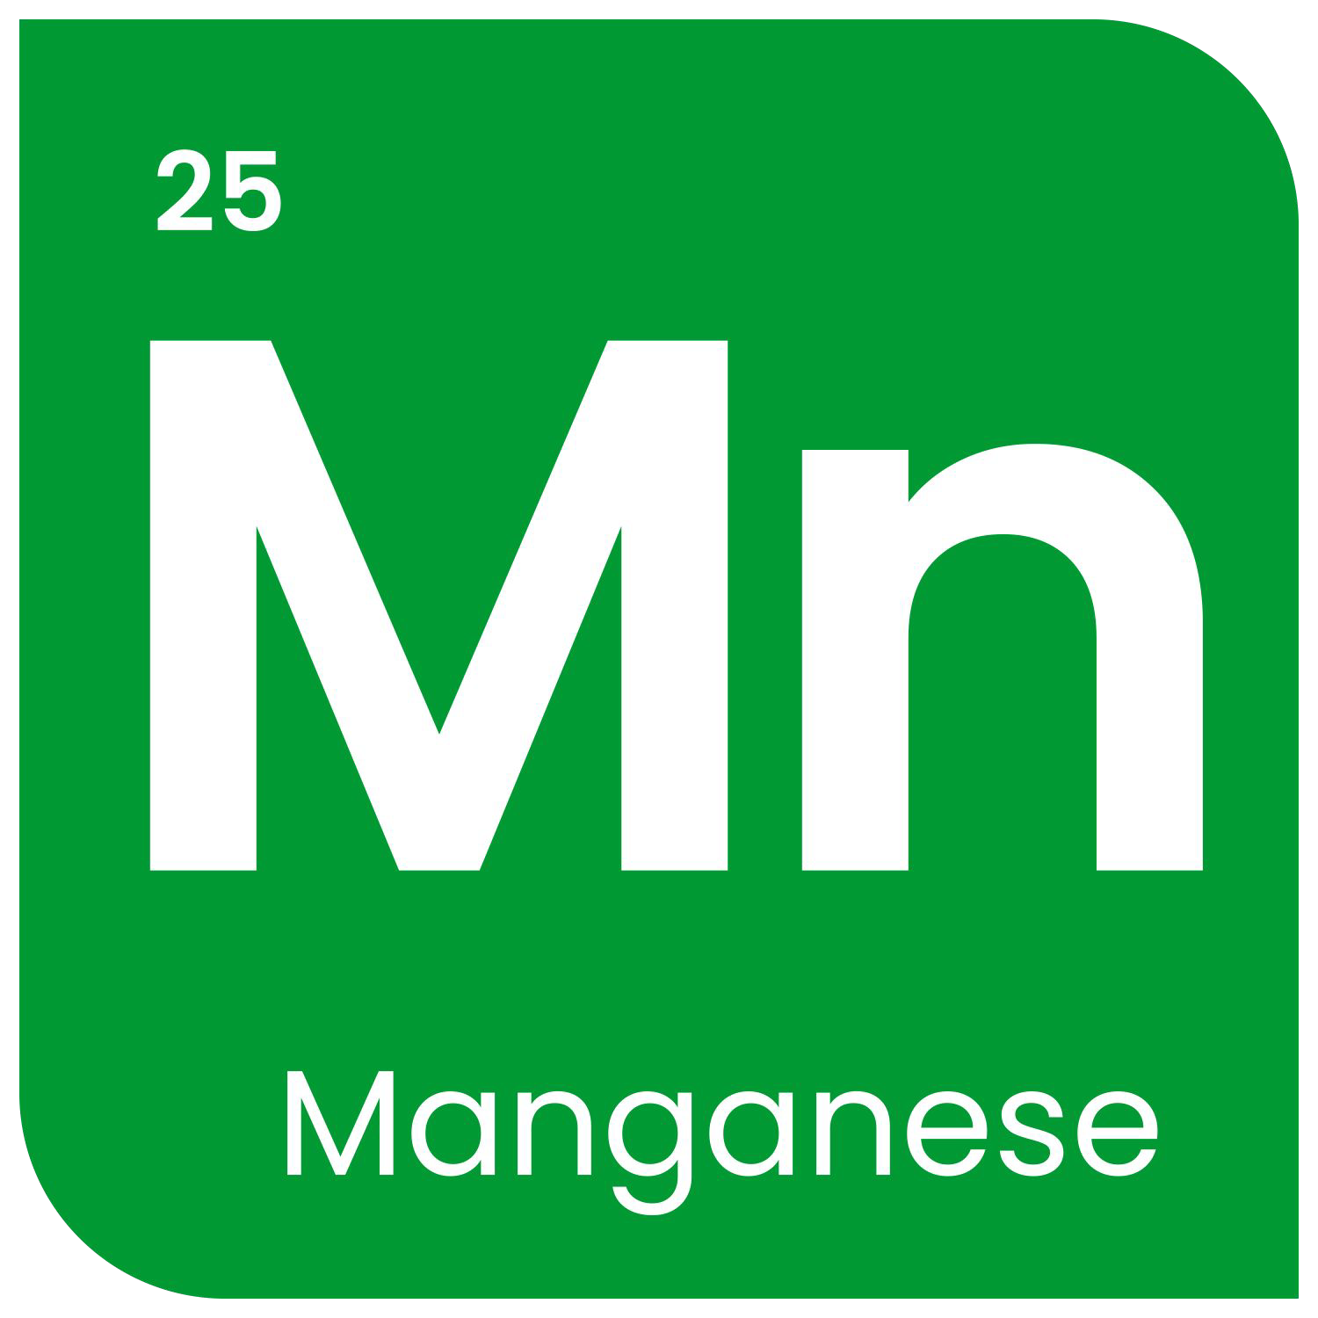
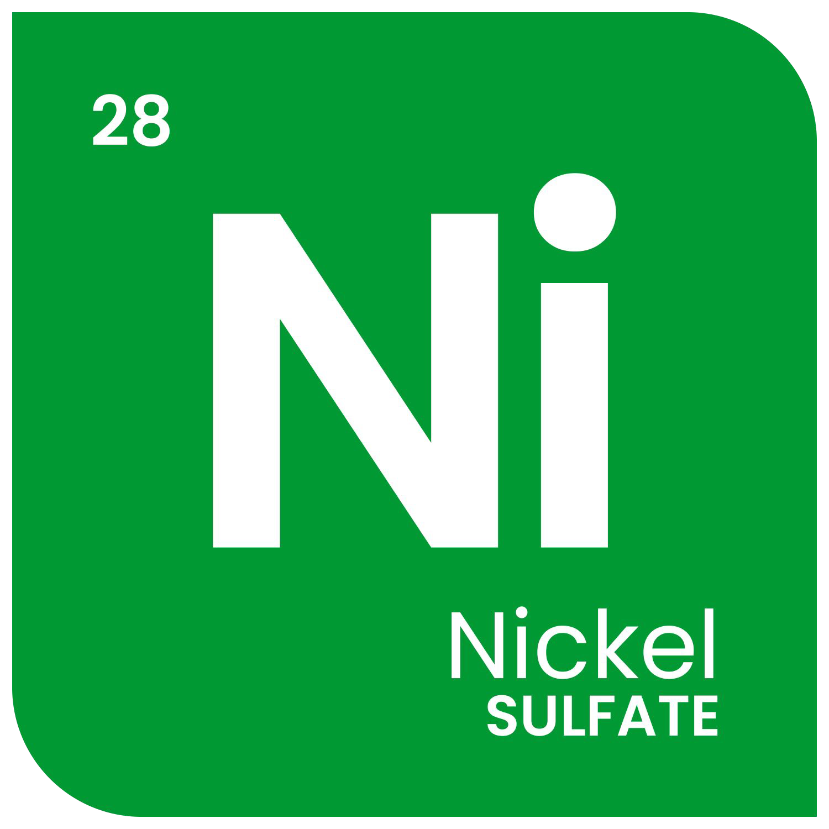


Key Problems with Li-Ion Battery Supply Chain
1) Land Ore Grades Decreasing Battery Metal Deficit by 2025 Metal Price increases
2) Increasingly unacceptable ESG
impacts
3) China Control
High-risk Locations Transportation costs
Environmental
Social
Governance

Slide 29


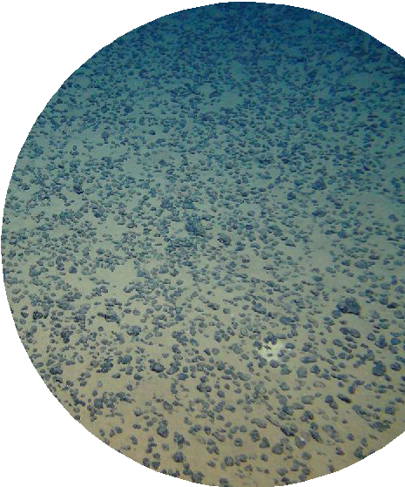


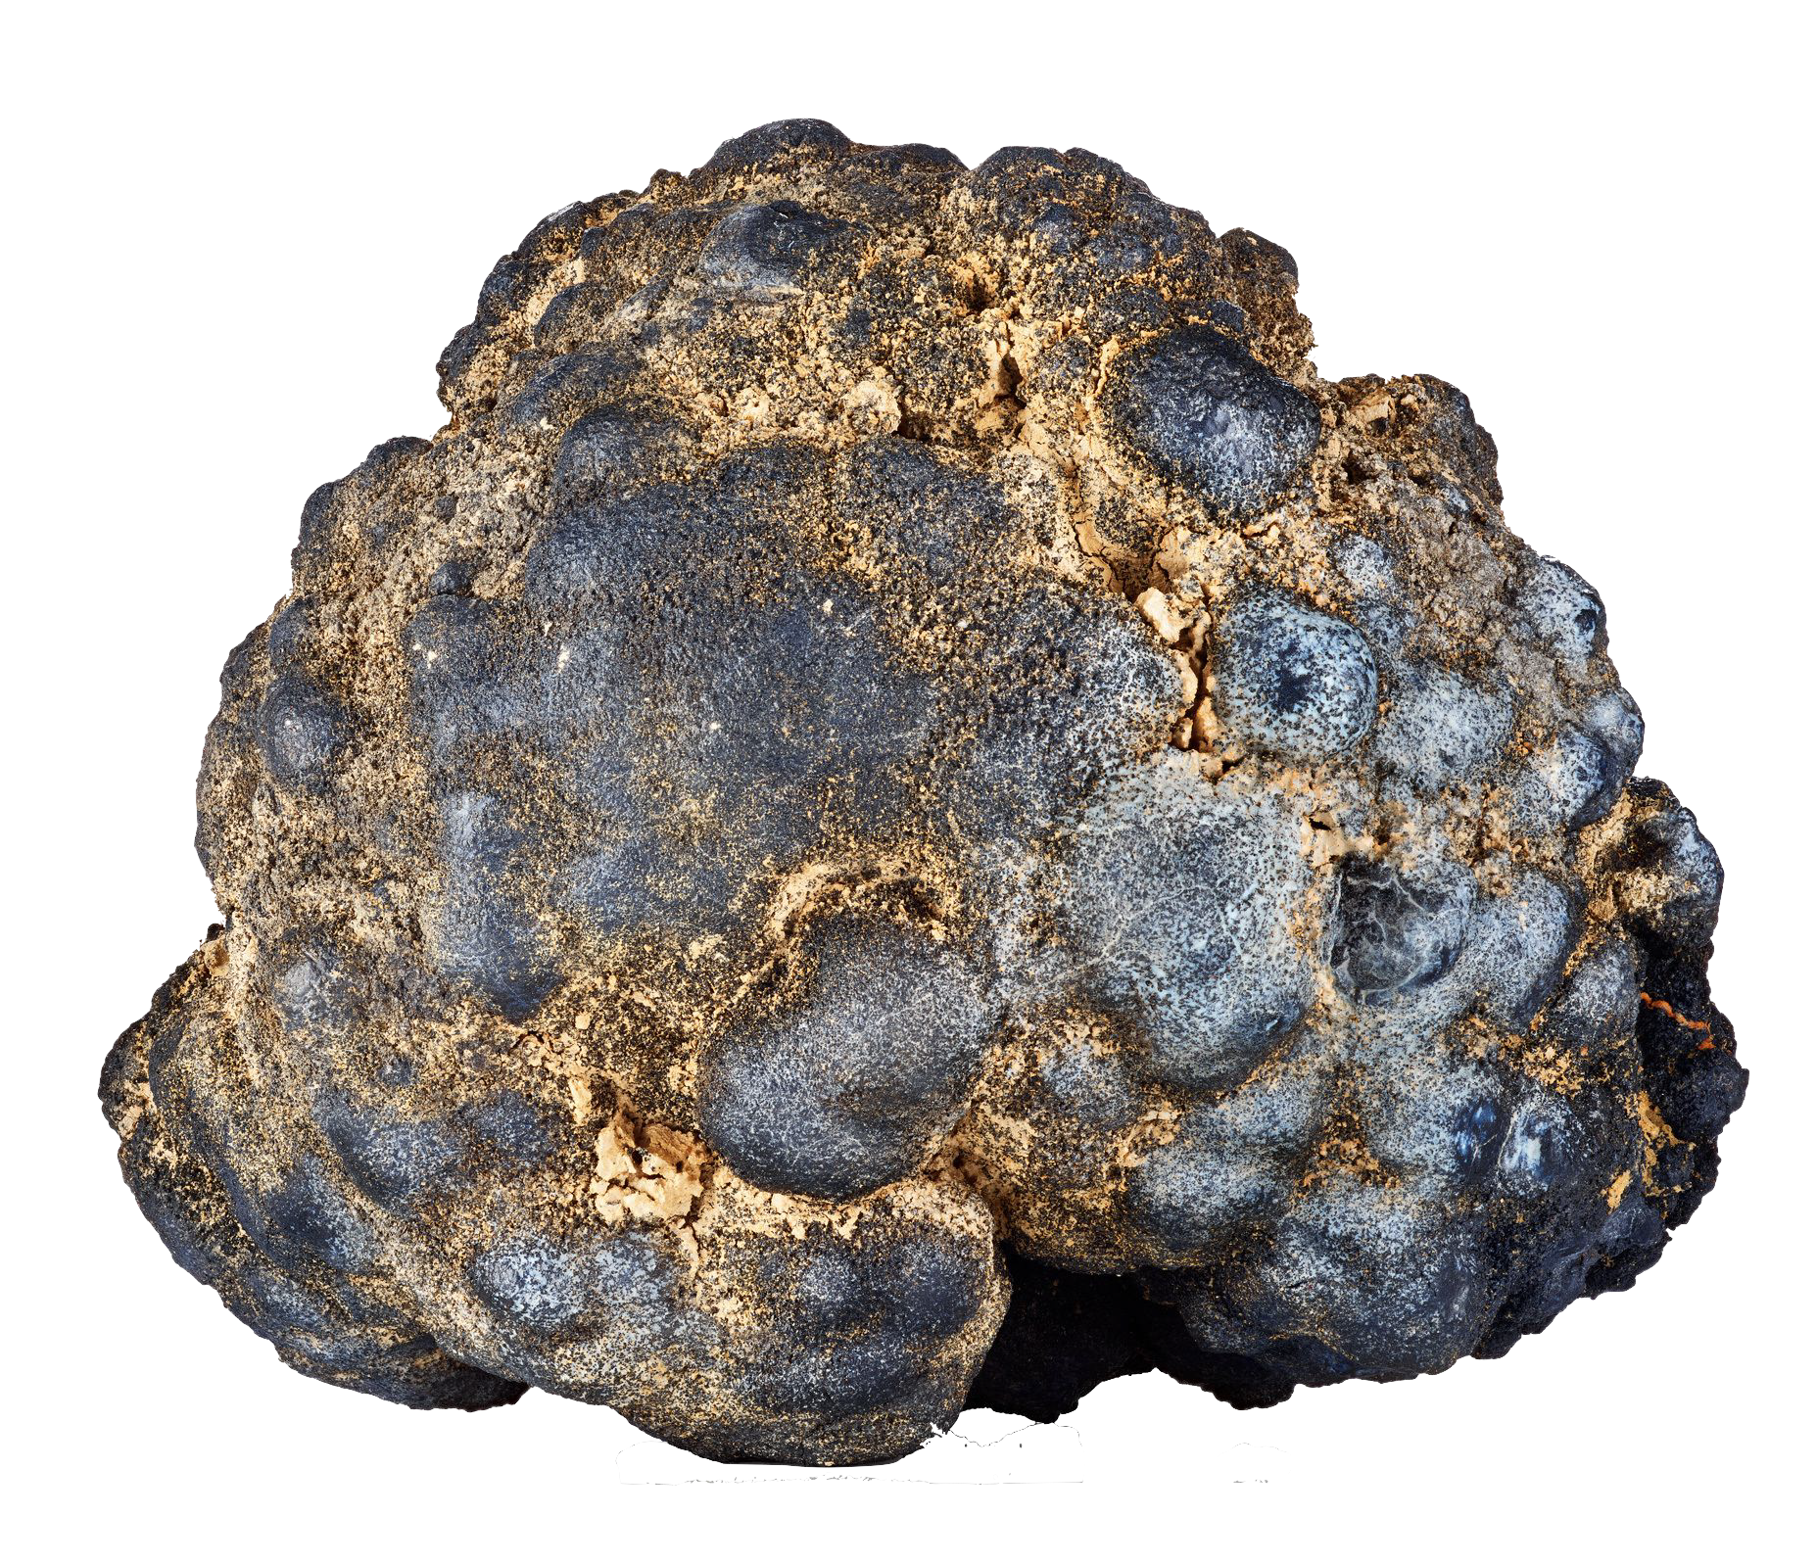

Polymetallic Nodule¹ Mining
Potato in Size
(5-10 cm diameter)
3-6 Km Deep
Average Abundance of Nodules
(kilograms per square meter)
~$503 per dry tonne
$4.5B pa (9 Mt)²
Clarion-Clipperton Zone 21 Billion Tons of Nodules (more Ni, Co & Mn
than in the rest of the world, $10T)
>30 kg/m²
12 B Tons
Indian Ocean
Cook Islands
Peru Basin
¹https://www.isa.org.jm/ﬁles/documents/EN/Brochures/ENG7.pdf ²The Metals Company Investor presentation March 2021
1.25-1.5% Nodules CCZ
0.2% Nodules Cook
1-0.1% Ni laterites Ore
0.1-0.25% Nodules CCZ
0.5% Nodules Cook 0.1% Co laterites Ore
1.00-1.4% Nodules CCZ
0.1% Nodules Cook
0.6% Ore
27-31% Nodules CCZ
15% Nodules Cook
31% Ore

Slide 30
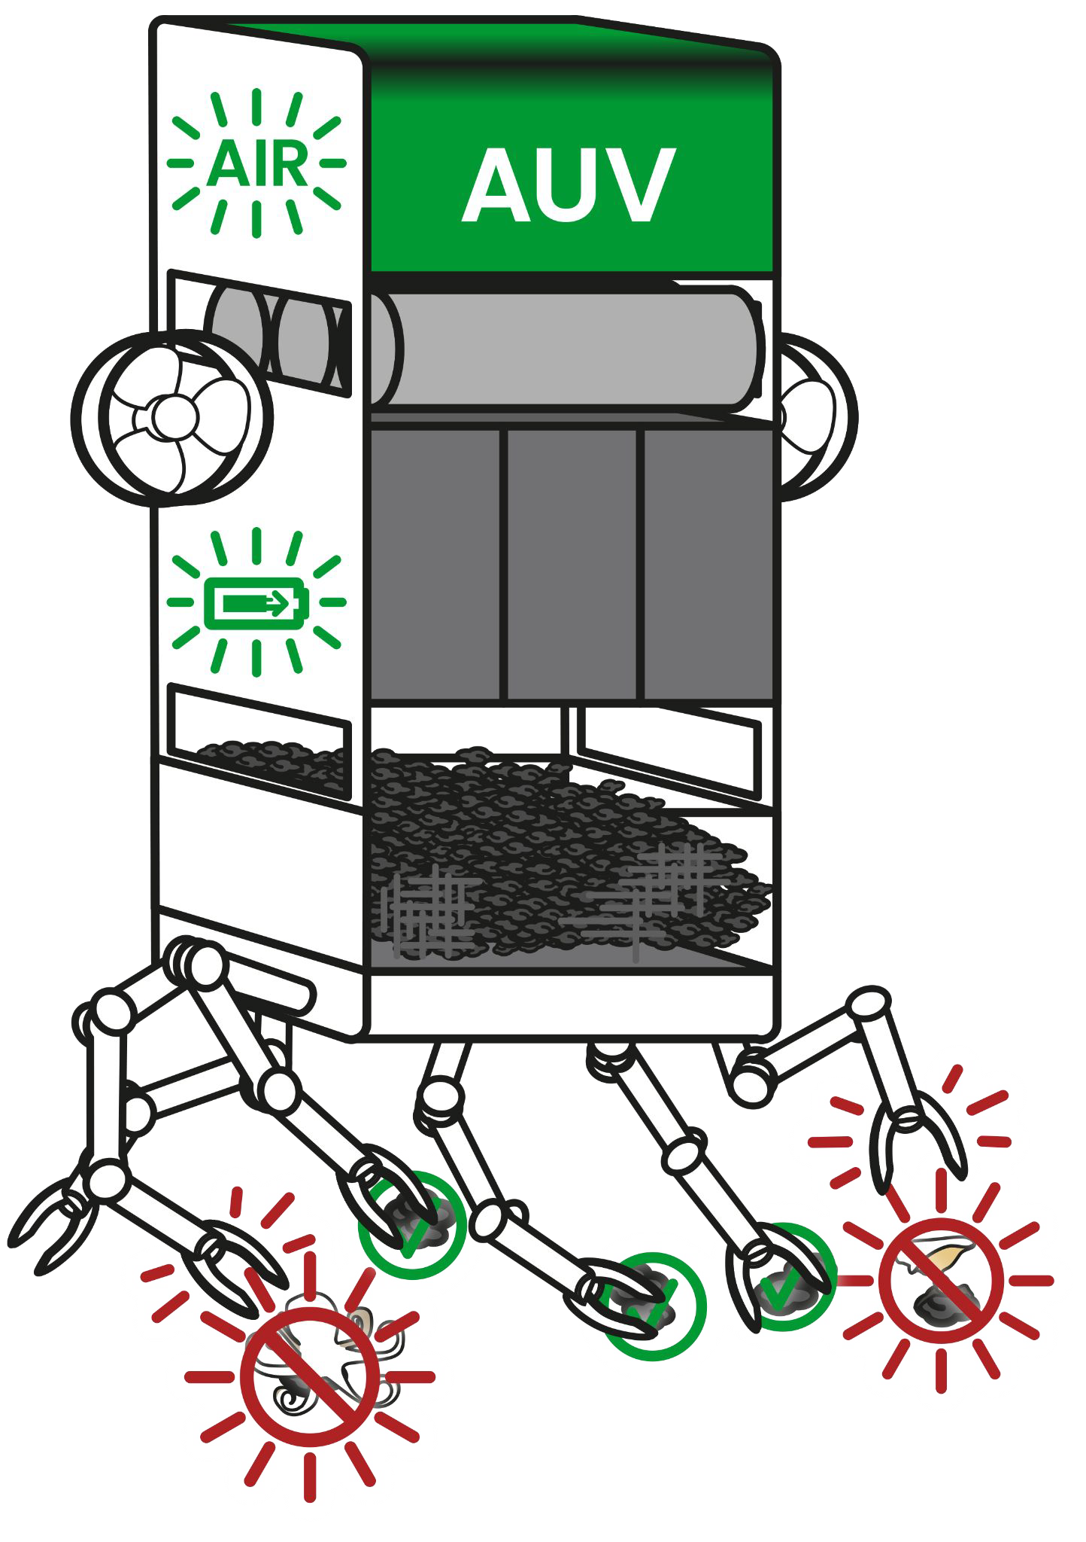
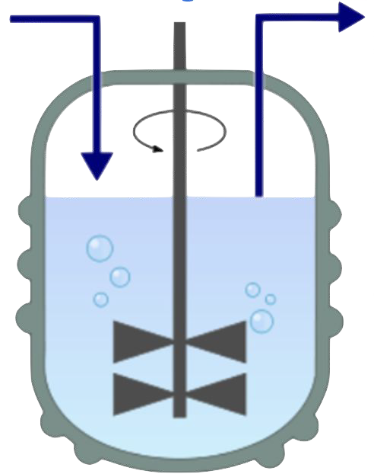
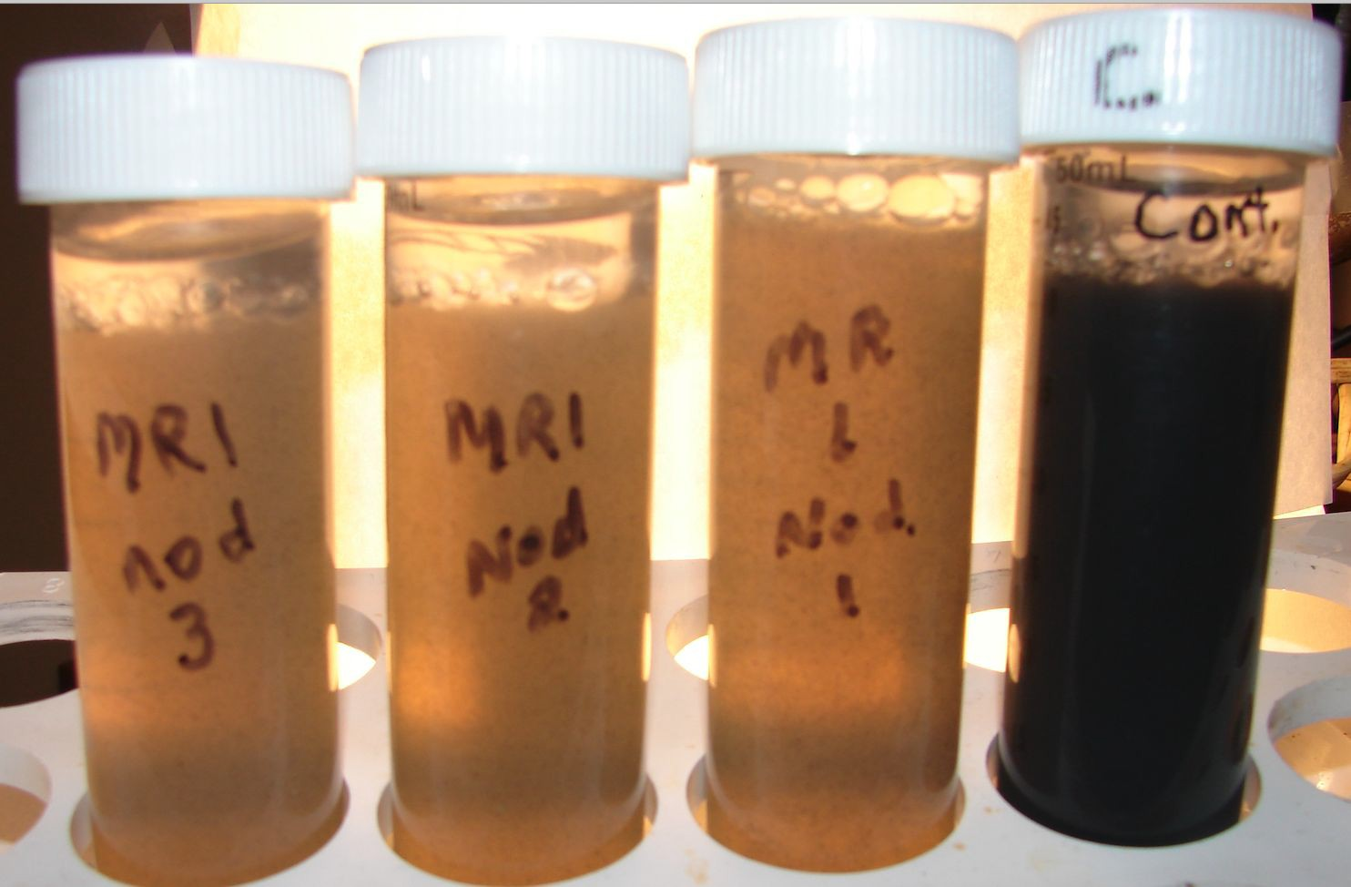
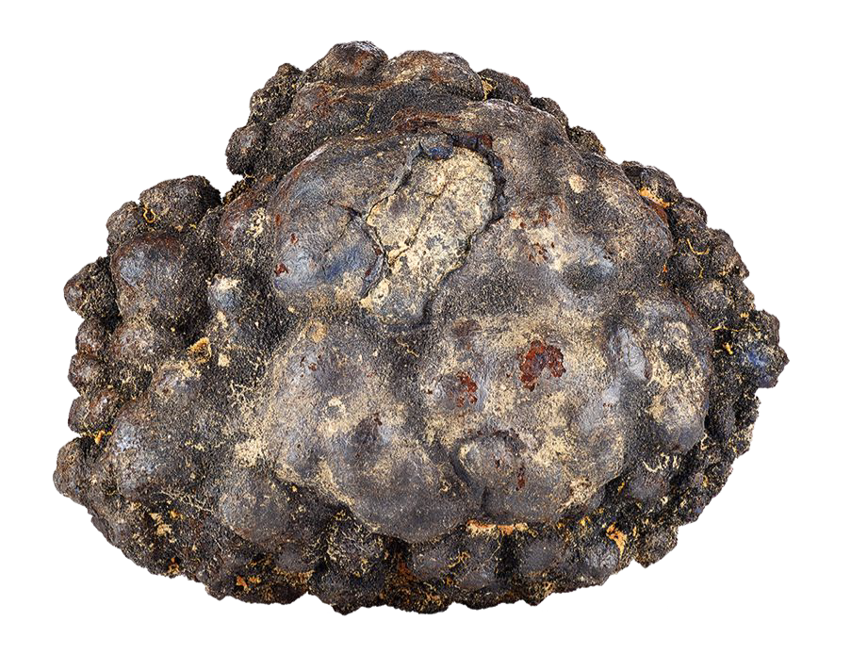
Company Summary
Robotic collection of polymetallic nodules
Abundant (largest source of battery metals)
High grade (>5x Higher Grade Than Land-based Mines)
Low production cost (33% less than competitors)
Very Low ESG impact
  selective pickup, no serious harm
Bio-Extraction (‘microbes breathing rocks’)
Naturally occurring bacterial respiration
No use of acids or reagents
Low energy (carbon neutral)
Patents pending
  ore processing and battery recycling

Slide 31
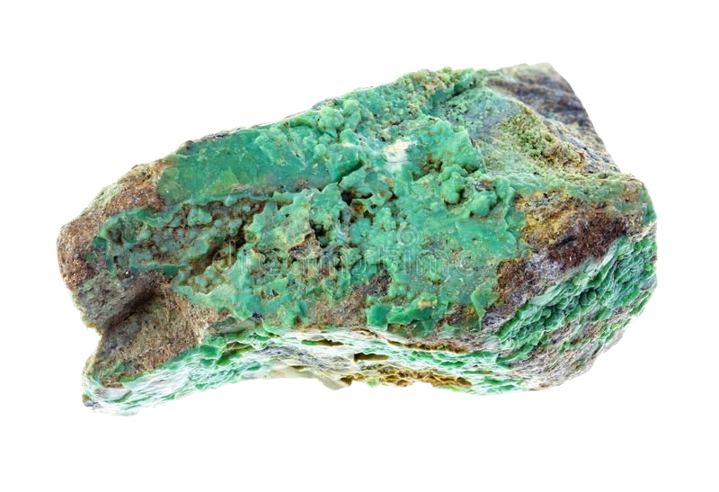
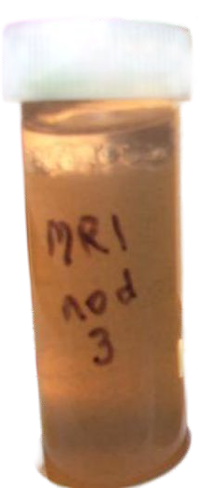
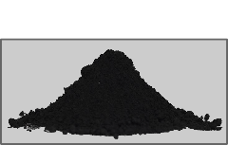
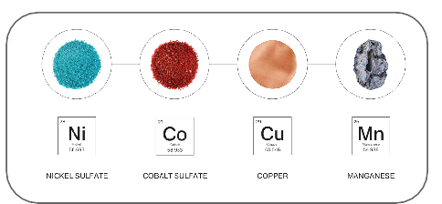
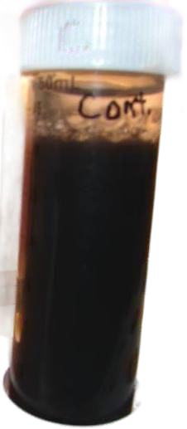
Bio-Extraction Process
Terrestrial Ore
4: Biomass/ Metal Separation
Dissolved metals
Commercial Grade Trace Metals
1: Comminution
2: BioExtraction
5: Recovery
3: Biomass
Li-Ion Black Mass
Fresh biomass
Shewanella & Geobacter group
metal recovery ~85%
~100 microns
Polymetallic Nodules
water and Nutrients
Process water and Residues
New technology developed by us

Slide 32

Complex Barriers to Supply Chain for Batteries in the USA
Improved time to open mines or new sources
Improved material conversion processes
Reduced logistics cost and time
Improved battery technologies made of readily available materials

Slide 33

Thank You!

