Slide 1

WELCOME
Purdue Executive MBA Programs
Choosing the Path That’s Right for You
Dr. Aldas Kriauciunas
Executive Director
Purdue EMBA Programs

Slide 2


Your Options
Program Type | Degree | Employed | Networking | Work Experience | Geographic Range
Traditional | MBA | No | High | Low | High
Online | MBA | Yes | Low | Varied | High
Weekend or Evening | MBA | Yes | Medium | Low/ Medium | Low
Residency | MBA | Yes | High | Medium/ High | High

Slide 3
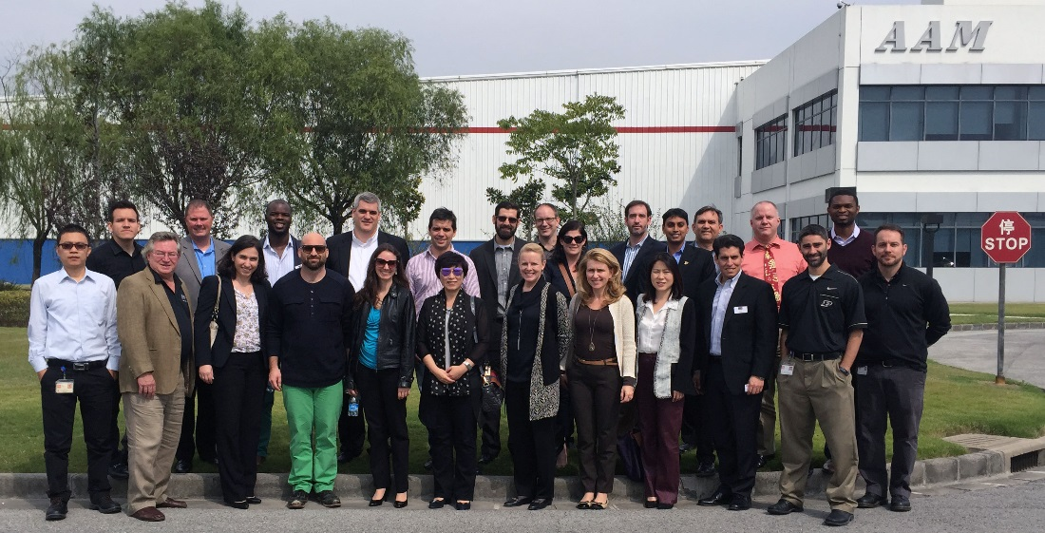

The Purdue Legacy
Purdue Overview
Founded in 1869
Purdue - land grant university.
Big Ten University:
  400,000+ Boilermaker alumni
  45,000+ Krannert alumni
  3,000 Executive MBA alumni
Leader in 200+ major areas: many resources
The Difference for You:
  People
  Format
  Cohort
  Personalized Program
  Return on Investment

Slide 4






















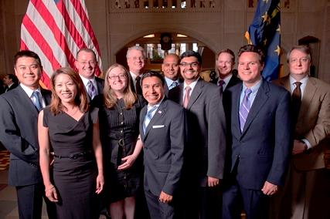
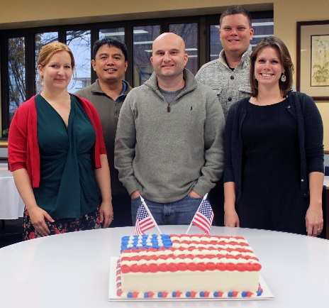




People – Purdue Students

Slide 5
Our Students

Slide 6



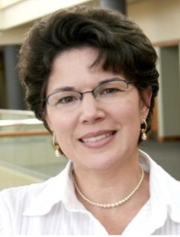
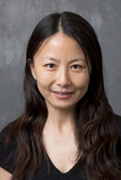
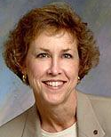


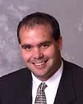


People – Purdue Faculty
People – Faculty
Operations
HR Mgmt.
Accounting
Project Mgmt.
Supply Chain Mgmt.
Finance
Marketing
Finance
Leadership
Strategy
Presentations

Slide 7

Structure - Module
Format
19 months from start to end
Orientation at Purdue: 4-5 days
Pre-residency: 8-10 weeks (online work)
Residency: 1-2 weeks (depends on module)
  Classes, company visits, guest speakers, career management, social events
Exam Period: 9 days (online)
Break: 1 week
Start next pre-residency with new study groups

Slide 8

Purdue EMBA Programs: Common Points Across Our Two Programs
Professionals with minimum 5 years work experience; average 13-16 years
Quarterly on-campus residencies (1-2 weeks) coupled with online preparation
General management MBA; 40% faculty overlap across programs
Network with professionals from across the U.S. & beyond
Capstone project and cohort-based electives
Career management support
Sept. Start: Tailored Curriculum
Five residencies in West Lafayette (1-2 weeks each)
Sixth, two-week residency abroad
Workshop style immersion electives – design your own curriculum choices
March Start: Global Focus
Five residencies of 2 weeks each in seven+ different countries.
Significant cultural & business immersion during residencies
Earn two MBA degrees: from Purdue and European partner

Slide 9



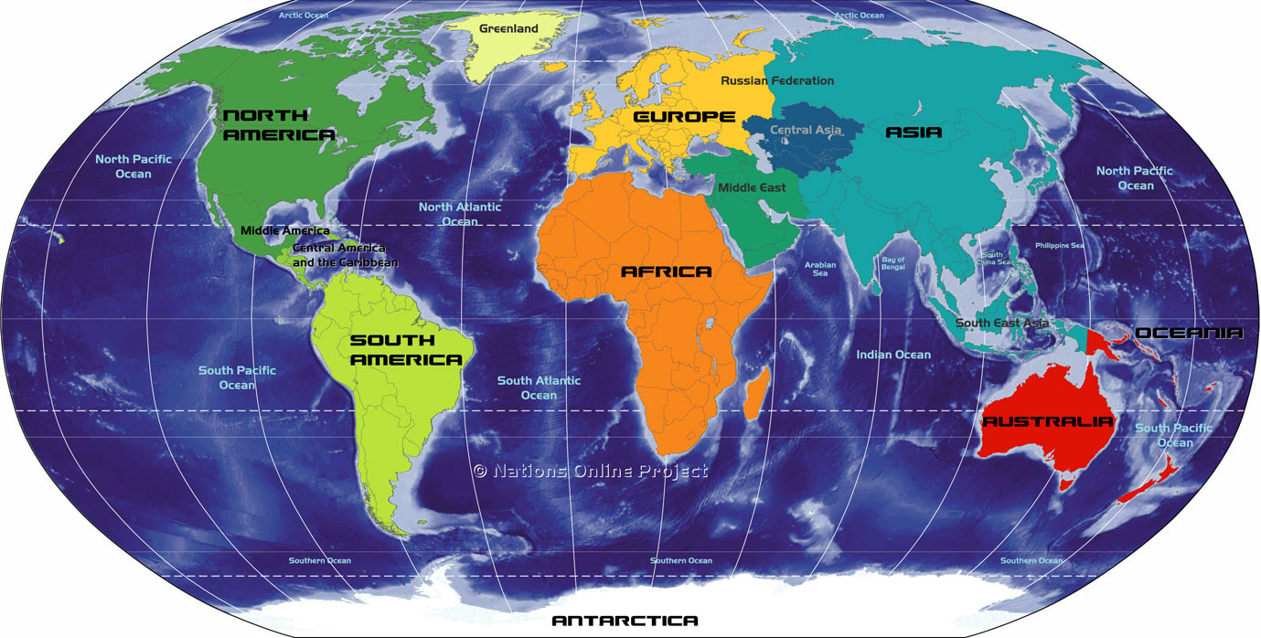



Structure - Global EMBA (IMM)
IMM Global EMBA
Alliance of five top business schools: Purdue University; TIAS (NL); CEU (Hungary); Tianjin University (China); FGV – EBAPE: Rio (Brazil).

Slide 10






Purdue - Return on Investment
IMM Timeline
Program Launch
Purdue University
March 20 – March 24, 2016
Module 1
Residency, TIAS, The Netherlands
June 6 - 18, 2016
Module 2
Residency at FGV-Rio, Brazil and Chile
October 2-15, 2016
Module 3
Residency at CEU, Budapest, Hungary & Istanbul Turkey
February 6-18, 2017
Module 4
Purdue Residency
June 12 – 24, 2017
Module 5
Residency in China
October 9 – 21, 2017
Graduation
Purdue University
December 16 – 17, 2017

Slide 11

Purdue - Return on Investment
Sample Module 2 Schedule: Santiago, CHILE
 | Sun. | Mon. | Tues. | Wed. | Thurs. | Fri. | Sat. | Sun.
6:30-8 | Breakfast | Breakfast | Breakfast | Breakfast | Breakfast | Breakfast | Breakfast | Breakfast
8:30-10 | Free | Mktng | Mktng | Mktng | Mktng | Mktng | Leader-ship | Depart
10:30-12 | Morning | Mktng | Mktng | Mktng | Mktng | Mktng | Mktng
12-1 |  | Lunch | Lunch | Lunch | Lunch | Lunch | Lunch
1-2:30 | Welcome | Leader-ship | Codelco | Leader-ship | Leader-ship | Leader-ship | Mktng
3-4:30 |  | Leader-ship | Visit | Leader-ship | Concha y | Leader-ship
Evening | City Tour |  | Group Dinner |  | Toro Visit | Farewell Dinner | Depart

Slide 12

Structure – EMBA Timeline
EMBA Timeline
Program Launch
Purdue University
September 12 - 16, 2016
Module 1
Purdue Residency
October 31 – November 12, 2016
Module 2
Purdue Residency
February 13 – 25, 2017
Module 3
Purdue Residency
May 1 – 6, 2017
Module 4
Purdue Residency
July 31 – August 5, 2017
Module 5
Purdue Residency
October 23 – 28, 2017
Module 6
International Residency
February 25 – March 10, 2018
Graduation
Purdue University
May 11, 12 or 13, 2018

Slide 13
Purdue - Return on Investment
Executive MBA Module 3, May 4-9
 | Mon. | Tues. | Wed. | Thurs. | Fri. | Sat.
7:30-8:30 | Breakfast | Breakfast | Breakfast | Breakfast | Breakfast/ Back to School | Breakfast
8:30-10 | Leadership & MIS | Leadership & MIS | Leadership & MIS | Company Visit | Leadership & MIS | M&A
10:30-12 | Leadership & MIS | Leadership & MIS | Leadership & MIS | Company Visit | Leadership & MIS | M&A
12-1 | Lunch | Lunch | Lunch | Lunch | Lunch | Lunch
1-2:30 | M&A | M&A | Immersion Elective | Immersion Elective | M&A | M&A
3-4:30 | M&A | M&A | Immersion Elective | Immersion Elective | Career Mgmt. | Travel Home
Evening |  | Dinner | Q&A with Purdue President | P&G CIO and Networking Reception | Dinner

Slide 14
Purdue - Return on Investment
Program Tuition: Coverage, Costs, and Timing
All-Inclusive Tuition Covers:
  Tuition
  Registration Fees
  iPad/ebooks/Course Materials
  Housing
  Local/Domestic Transportation
  Most Meals
  Social Events, Company Visits, Career Services
Your Responsibility: Travel to/from campus + some meals
Tuition is $80,000 split into 5 payments of $16,000 each.
Application Deadline: EMBA (June 30, 2016); IMM Global EMBA (December 31, 2015), – or until class is filled.

Slide 15
Benefits to You and Your Firm
Coursework: 48 credits across all disciplines.
Applications: Start to use your skills and knowledge while in program. Engage in new ways and increase impact.
Career Management: Guest speakers, networking receptions, online resources, coursework, and one-on-one executive coach consultation.
After Graduation: Online webinars, on-campus Back to School days, Purdue events.
Networks: Form lifelong ties with professionals from around the world, not just locally.

Slide 16
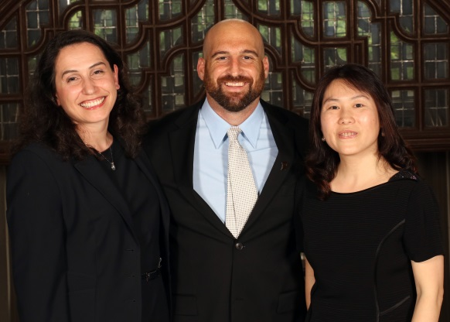
ROI/Salary Increases
Alumni enjoy accelerated rates of career advancement and promotion.
Purdue Executive MBA Program
Within two years of graduation, 63% have been promoted/grown their own company.
At graduation, salaries increase an average of 44% as compared to salaries at enrollment.
Within two years of graduation, salaries increase on average another 32%.
IMM Global Executive MBA Program
Within two years of graduation, 70% have been promoted/grown their own company.
At graduation, salaries increase an average of 25% as compared to salaries at enrollment.
Within two years of graduation, salaries increase on average another 49%.
Source: The Economist EMBA Rankings 2015

Slide 17
Next Steps – Financing
Company Support
Personal
Tap company’s reimbursement for full or partial sponsorship
90% of students in program receive some tuition assistance
Inquire early - getting reimbursement approved can be a lengthy process
Purdue can provide cost breakdown (tuition, housing, books)
EdAssist discount
Personal savings
Private loans
VA Benefits - Post 9/11 GI Bill
Claim education tax credits/deductions
Stafford loans (U.S. citizens)
Dean’s Scholarships
2+ from same firm = 10% off
Contact KIRSTEN REYNOLDS
Purdue’s Financial Aid Office
kdreynol@purdue.edu

Slide 18
Next Steps – Financing
Non Residents/Citizens
Can apply for private loan, but will need U.S. citizen as co-borrower.
U.S. Citizens/Permanent Residents
First step – complete FAFSA form (fafsa.ed.gov)
Eligible for up to $20,500 Stafford Loans every two terms (5.84% interest rate). The program covers 5 terms.
Also can apply for Graduate Plus Loan. 6.84% interest rate. (studentloans.gov)
Purdue email: dfa_pec@purdue.edu

Slide 19

Next Steps
Next Steps
Request: 5-Part Personalized Engagement Package
  Resume review to determine fit
  Program comparison with 3 schools of your choice on 23 dimensions
  EMBA Experience (Feb 19, May 6, 2016) + Webinar (Dec 8, Jan 21, 2016)
  EMBA On the Road: Chicago/NW Indiana, Michigan, Seattle,Texas and more.
Initiate the Application Process
  Online application (incl. essays, references)
  Resume (with 5+ years work experience)
  Transcripts (bachelor’s degree minimum)
  GMAT/TOEFL Waivers
  Rolling admissions process
Start program: Global Executive MBA (March 20, 2016); Executive MBA (Sept 12, 2016)
Contact us with any questions:
  Jo Ann Whitford; 765-494-4580; jwhitfor@purdue.edu
  Aldas Kriauciunas; 765-496-1860; akriauci@purdue.edu
  Visit us online at www.krannert.purdue.edu/executive

