Slide 1
GSCMI Center Updates
Ananth V Iyer
Susan Bulkeley Butler Chair in Operations Management
Director, GSCMI
Krannert School of Management
Purdue University
aiyer@purdue.edu

Slide 2
GSCMI Staff
Ananth Iyer, Director
Steve Dunlop, Managing Director
Heidi Allwes, Center Coordinator

Slide 3
Outline
Center Goals
WHIN Supply Chain Project
DOE EV Demand Scenarios
Future Goals

Slide 4
Using Supply Chain Capacity to produce emergency orders
Map short term capacity at many suppliers
Identify buyer product needs, process plans, volumes
Identify buyer constraints such as
All production at one supplier and using one process plan
Production at one supplier but multiple plans OK
Production at multiple suppliers and process plans OK
Associated cost and decisions
Benefit – how do we expose tier 3 and 4 capabilities to OEMs?

Slide 5
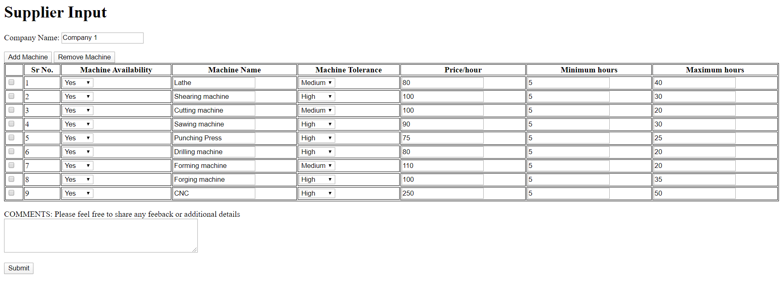

Slide 6
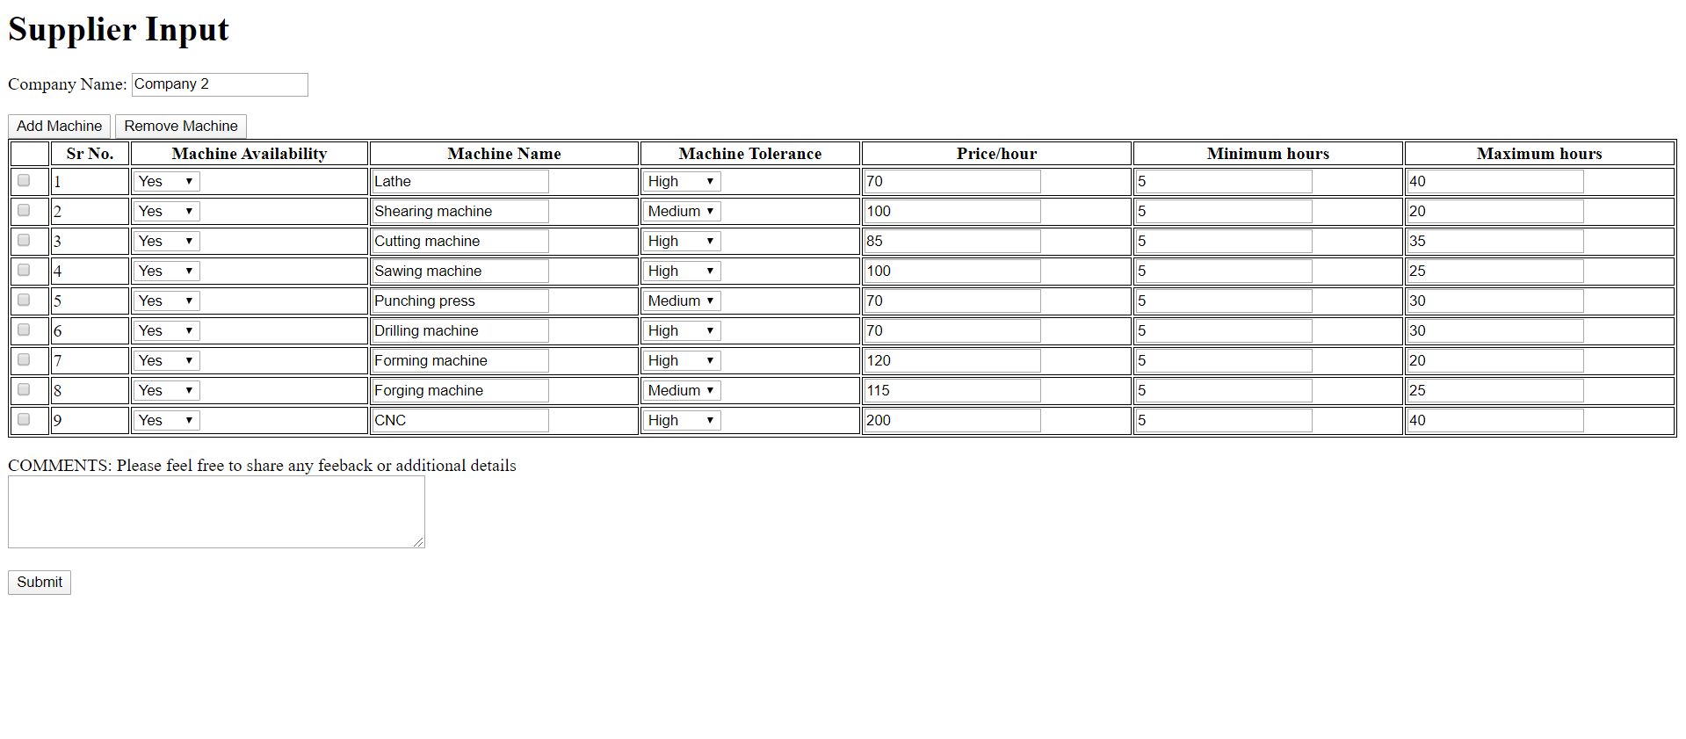

Slide 7
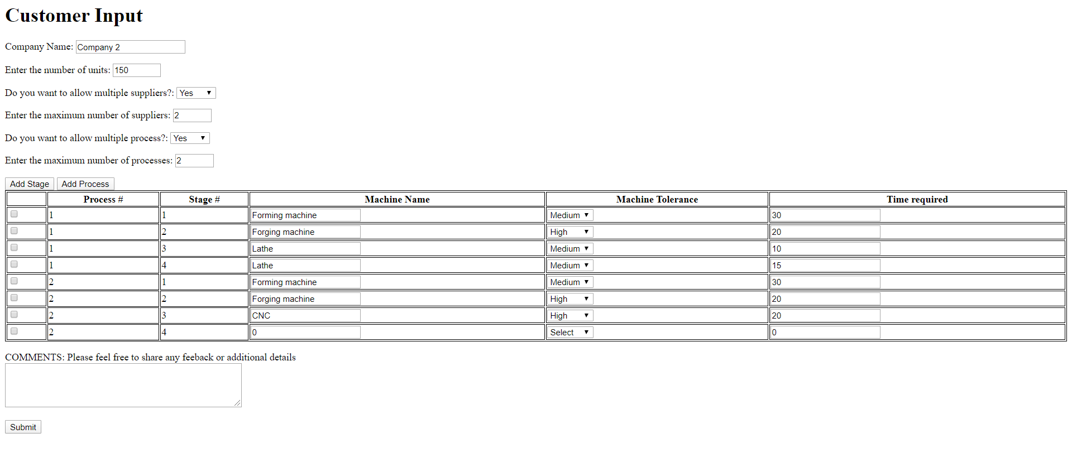
Product Name- Fastener

Slide 8
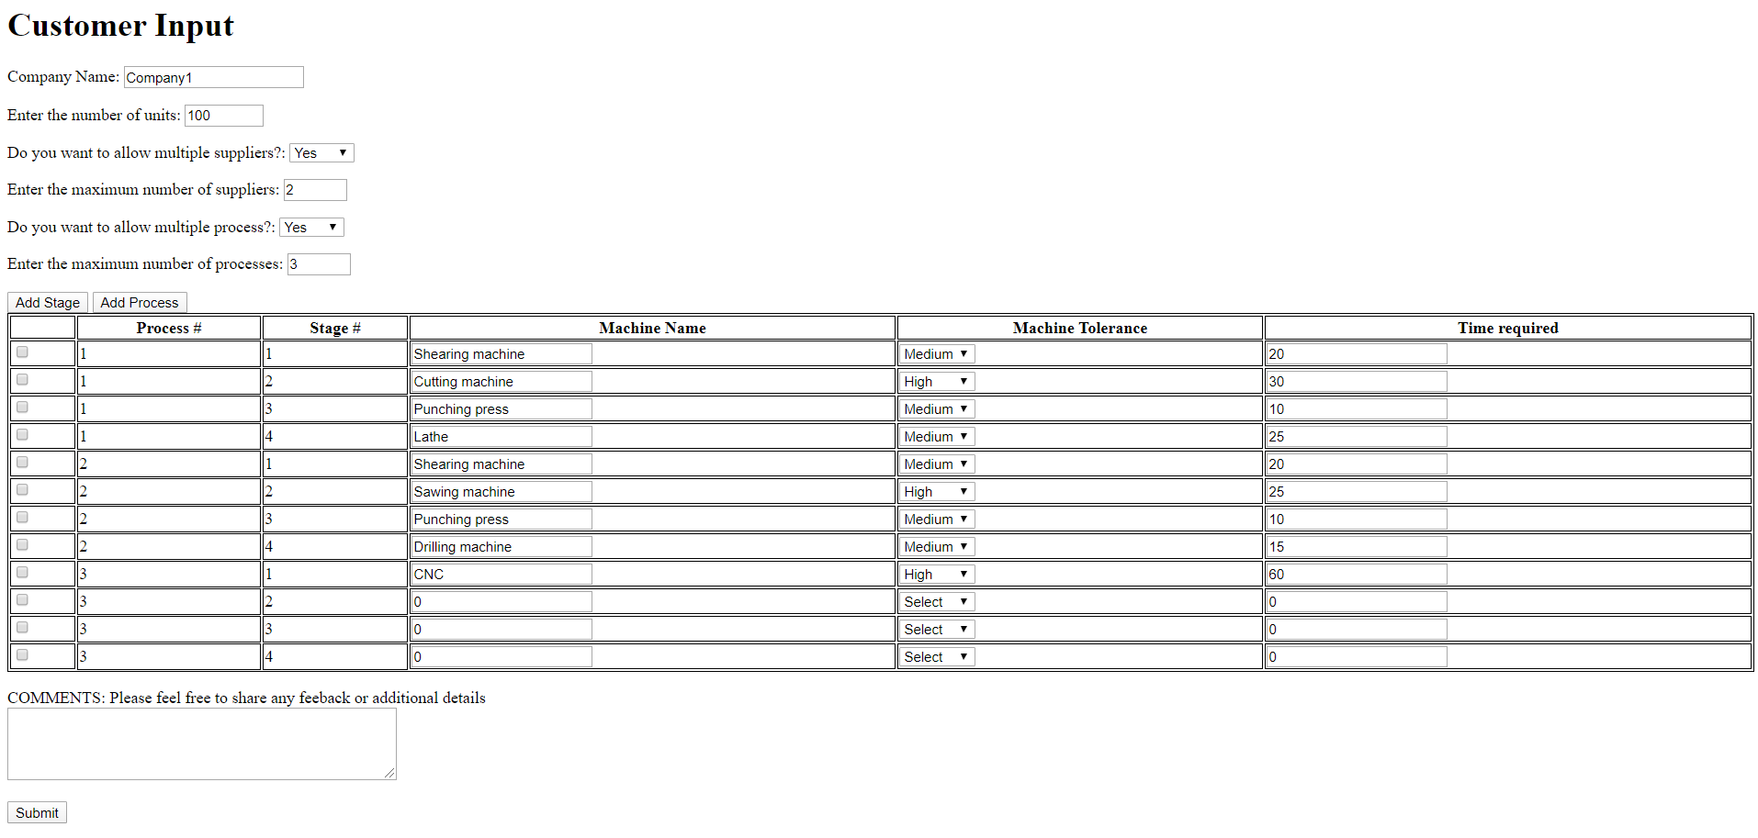
Product Name- Dura Plate

Slide 9
Concept
Develop an optimization model that identifies the lowest cost capacity plan across suppliers
Satisfy buyer constraints
Satisfy supplier minimums or maximums
Maintain benefits increasing in flexibility

Slide 10
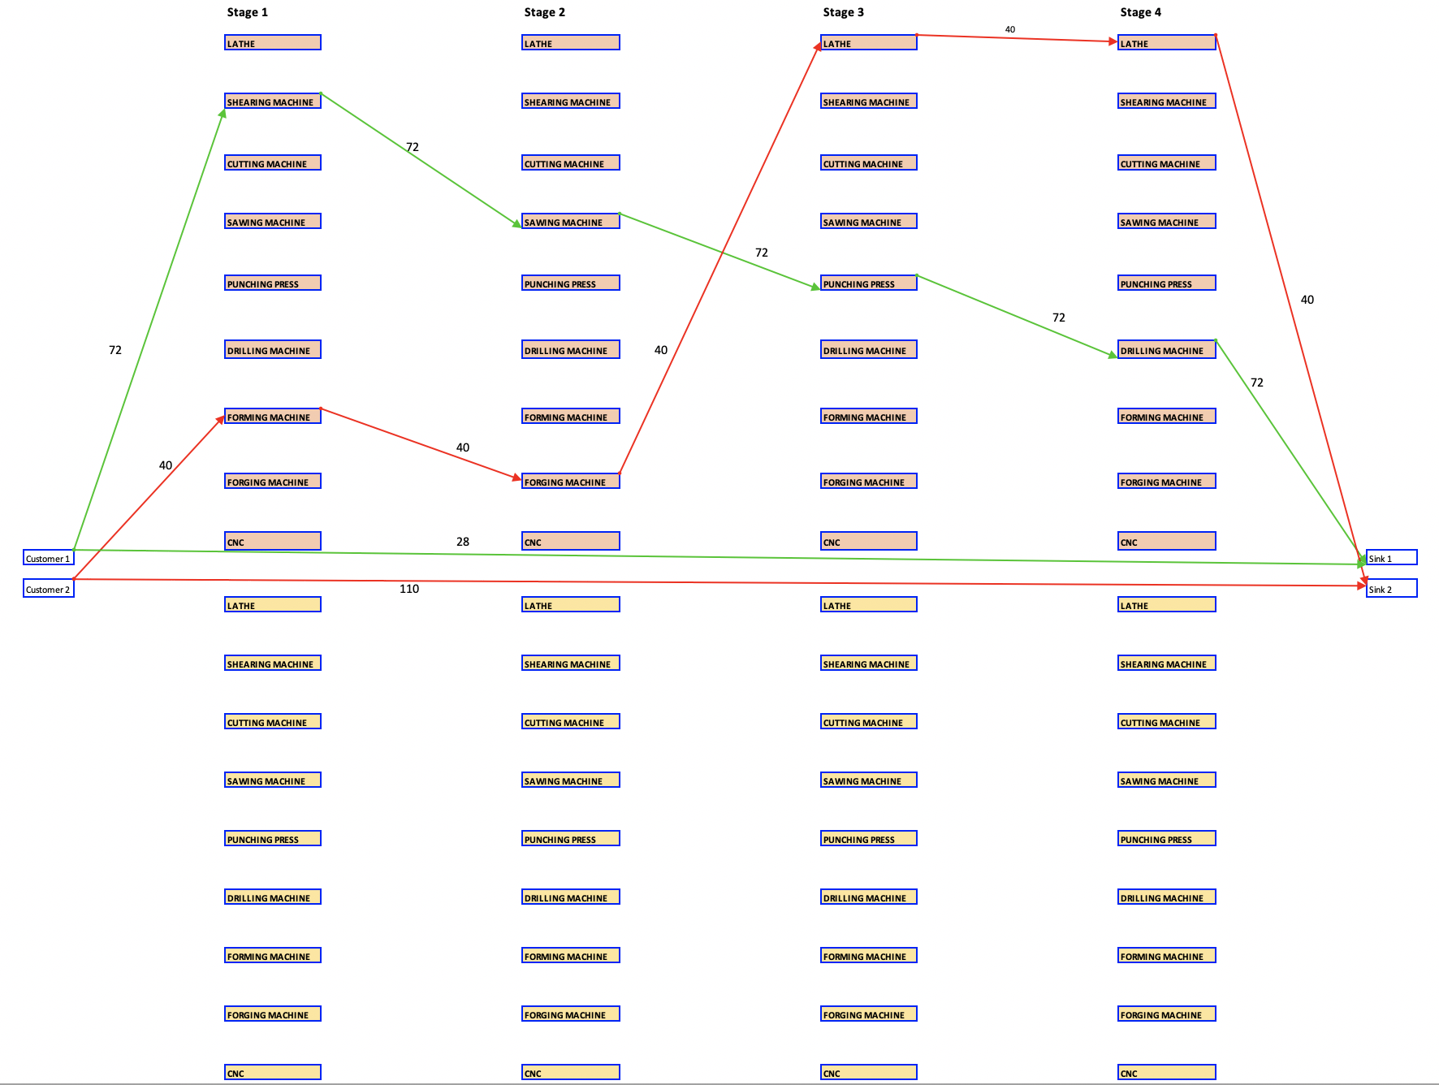
Single Supplier, Single Process

Slide 11
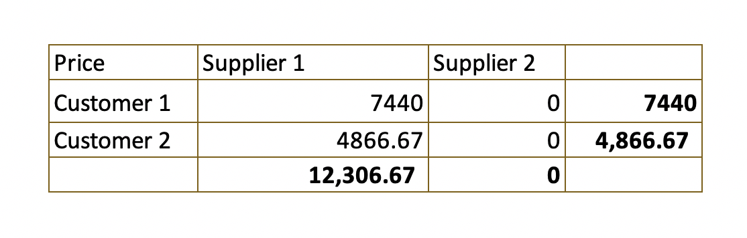
Single Supplier, Single Process Bill
Both customers allocated to Supplier 1, not all demand satisfied
(Cost = 12,306.67, 112 units produced, 138 units not produced, Average cost = 109.88)

Slide 12
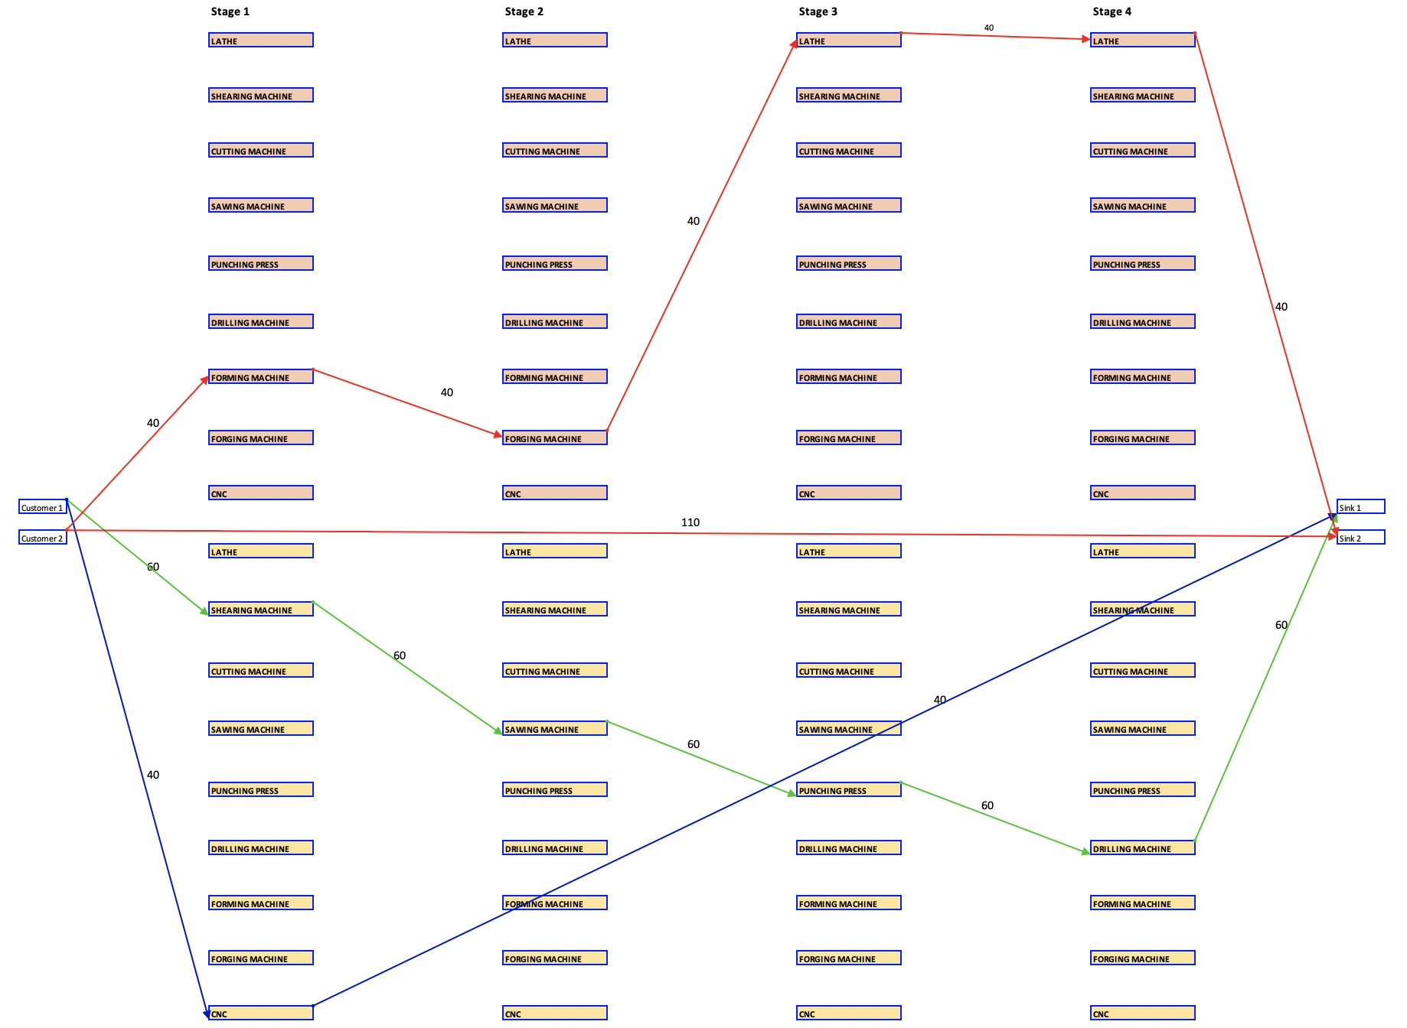
Single Supplier, Multi Process

Slide 13
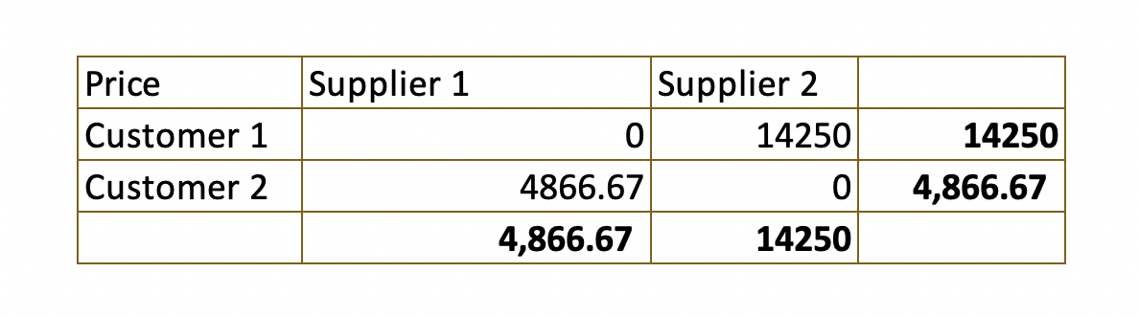
Single Supplier, Multiple Processes OK, Bill
Production split across suppliers. Total cost = 19116.67, Units produced = 140, Units not produced = 110
Avg cost = 136.54/unit

Slide 14
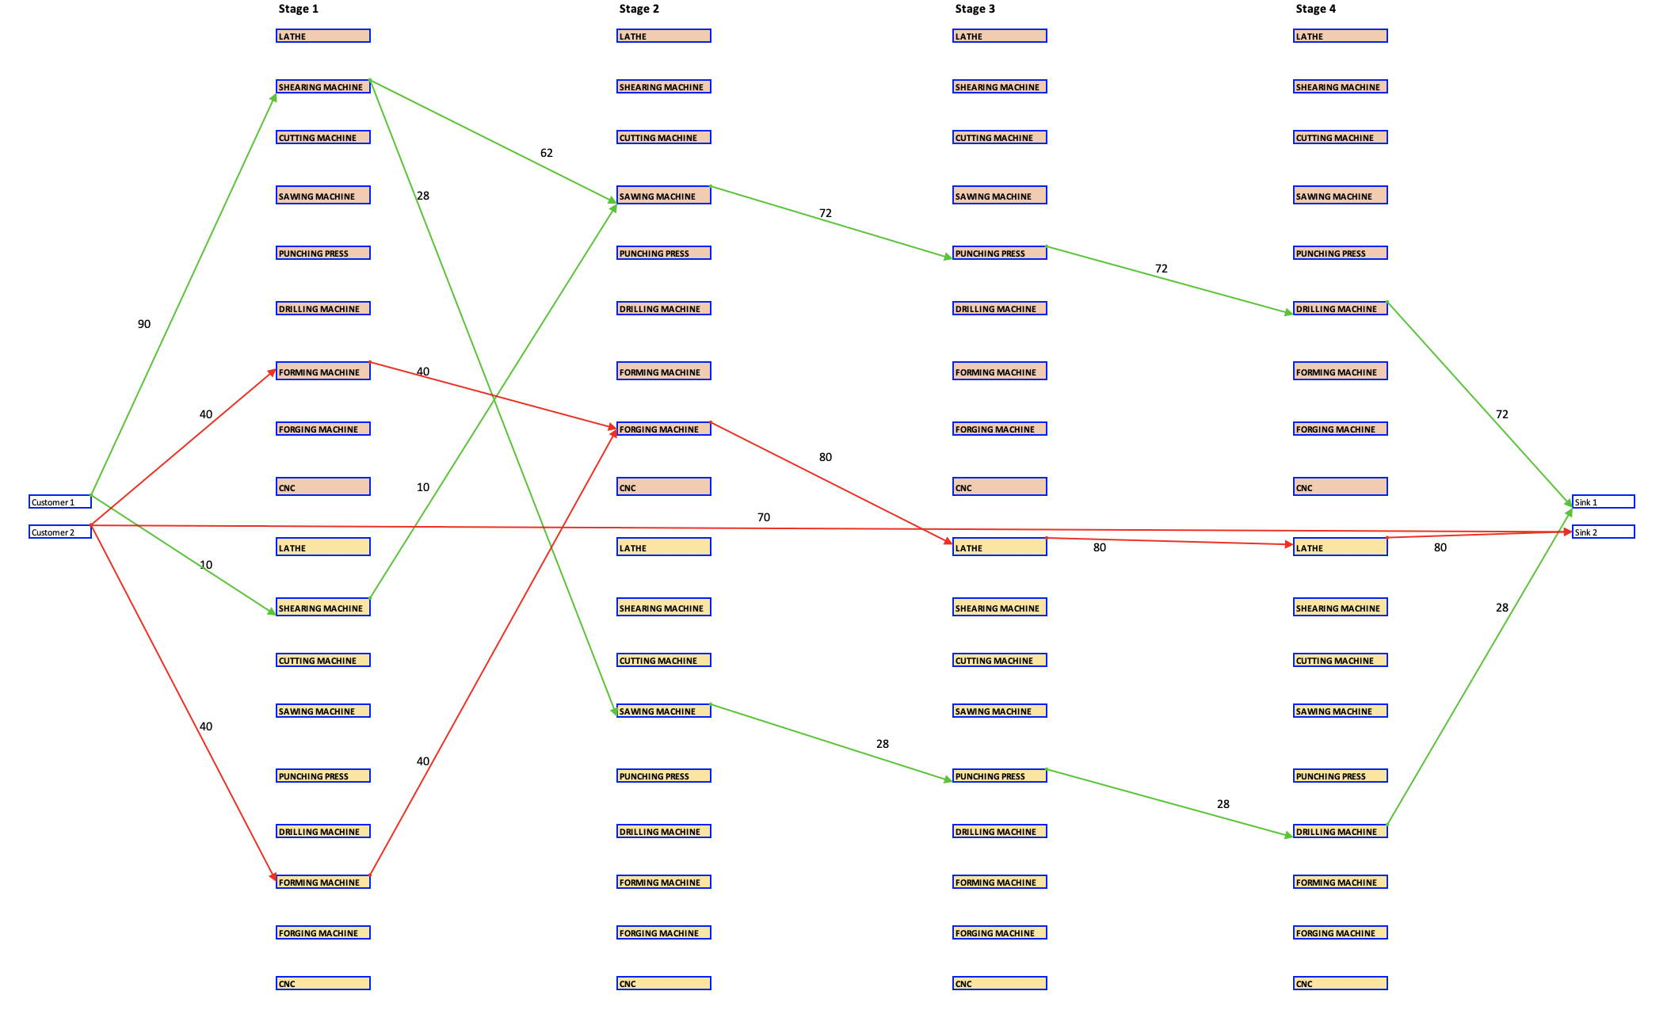
Multi Supplier, Single Process

Slide 15
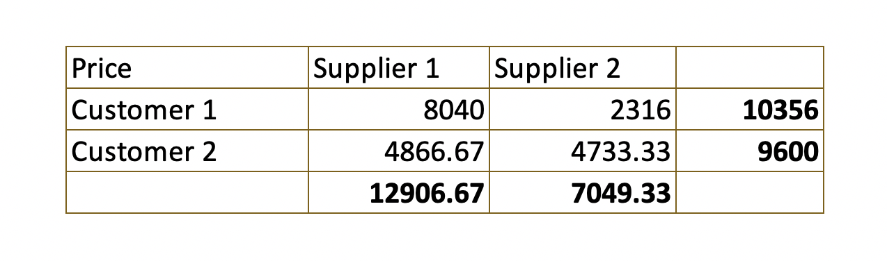
Bill
Production split across suppliers, Cost = 19,956
Units produced = 180, units not produced = 70, Avg cost = 110.87

Slide 16
Summary
Customer process flexibility enables more units to be produced spread across equipment
Supplier flexibility enables more capacity
The benefit is more units produced over the required time, regionally
A step towards Smart Manufacturing Ecosystems

Slide 17
Demand Scenarios for EV Battery related Critical Materials and Supply
Ananth V Iyer
Susan Bulkeley Butler Chair in Operations Management
Department Head and Senior Associate Dean
Krannert School of Management
Purdue University
aiyer@purdue.edu
Graduate Students:Shruti Singhal, Atul Kulkarni

Slide 18
Goal of the project
Understand
Growth in demand for Electric Vehicles,
Which will impact sales of batteries,
And choice of technology for batteries,
Result in demand for critical materials forecasts
Interact with supply projections
To highlight market opportunities for CMI technologies

Slide 19
The Problem and our Approach
The Problem
Current projections across consultants and agencies vary widely
Their logic for projections is not clear
The impact of geopolitical trends is not linked to forecasts
The impact of regulatory choices is not clear
The impact of choice of technologies by industry is not clear
Our Approach:
Provide a transparent link between scenarios and forecasts and demonstrate that the different forecasts can be interpreted as different assumptions regarding future geopolitical, regulatory and technology scenarios

Slide 20
EV projections by agencies
6 m
1.45 m

Slide 21
Our Approach
Start with SSPs (Socio-Economic Pathways) calibrated by IPCC (following the Fall CMI presentation by Tom Graedel)
Include Regulatory Choice Pathways (RCP) which restrict the radiative forcing (W/m2)
Include Industry trends regarding technology being chosen (batteries and magnets)
Project the material demand based on SSP and RCP and Technology trends
Link to the Supply Projection to generate market opportunities for projects

Slide 22
SSP 1: predicts a world of sustainability-focused growth, i.e. taking the green road
Shifts away from fossil fuels and environmental conditions improve over time. Educational and health investments accelerate the demographic transition, and the emphasis on economic growth shifts toward more emphasis on human well-being. Driven by an increasing commitment to achieving development goals, there are tighter regulation for pollutants and inequality is reduced both across and within countries. Consumption is oriented toward low material growth and lower resource and energy intensity
SSP 2 is the middle of the road where prediction follows historical events
This is the current scenario where world follows historical patterns of social, economic, and technological trends. Global population growth is moderate and there is continued dependence on fossil fuels. Global and national institutions work towards achieving sustainable development goals but make slow progress. Environmental systems experience degradation, although there are some improvements and overall, the intensity of resource and energy use declines. Income inequality persists or improves very slowly.
SSP 3 represents a fragmented world/ Regional rivalry
Energy and food security goals are focused on region than being global. Investments in education and technological development decline. Economic development is slow, consumption is material-intensive, and inequalities persist or worsen over time. Population growth is low in industrialized and high in developing countries. Low priority for addressing environmental concerns leads to serious environmental degradation in some regions.

Slide 23
SSP 4 is a world of ever-increasing inequality
Increasing disparity in economic opportunity and political power results in increasing inequalities and stratification both across and within countries. Over time, the gap widens between an internationally-connected society (that contributes to knowledge and capital-intensive sectors of the global economy) and a fragmented collection of lower-income, poorly educated societies (that work in a labor intensive, low-tech economy). Social cohesion degrades and conflict and unrest become increasingly common. Technology development is high in the high-tech economy and sectors. Environmental policies focus on local issues around middle and high income areas.
SSP 5 predicts a world of rapid and unconstrained growth in economic output and energy use/ Fossil-fueled Development
Global markets are increasingly connected. There are also strong investments in health, education, and institutions to enhance human and social capital. At the same time, the push for economic and social development is coupled with the exploitation of abundant fossil fuel resources without considering alternative sources. All these factors lead to rapid growth of the global economy, while global population peaks and declines in the 21st century. Local environmental problems like air pollution are successfully managed. There is faith in the ability to effectively manage social and ecological systems, including by geo-engineering if necessary.

Slide 24
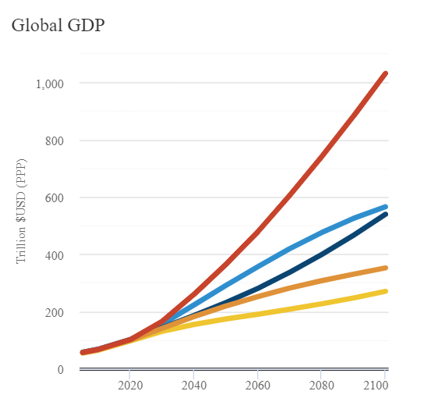
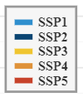
Baseline emissions and GDP projections
SSP | SSP1 | SSP2 | SSP3 | SSP4 | SSP5
Baseline Scenario | 5.5 | 6.7 | 7.2 | 5.8 | 8.5
Baseline emissions vary with scenarios.
SSP5
GDP projections vary significantly by SSP
Scenario | Region | 2050 | In US $2005 billions/year
SSP1 | World | 284564.683
SSP2 | World | 229718.399
SSP3 | World | 177283.735
SSP4 | World | 219216.134
SSP5 | World | 360926.061
SSP1
SSP2
SSP4
SSP3
All SSP data available at
https://tntcat.iiasa.ac.at/SspDb/dsd?Action=htmlpage&page=20

Slide 25
Relation between GDP and Cars produced
Initial Research and Analysis
on
Electrochemical Graphitization
$\frac{Cars produced}{World GDP}(beyond 2017)$ $=0.009219∗(t)+0.758077$; (where, t = Year-1998)
Reference: Worldometer

Slide 26
Future EV % of Total Vehicle Demand by SSP and RCP
The forcing function (RCP) affects the electric vehicle mix as a part of global fleet of vehicles. Hence for baseline SSP scenarios, fraction of EVs vary with their baseline RCPs as follows:
$$Global EV \%=\left(−0.06829∗RCP\right)+0.737561$$
 | Global EV % (in 2050) | RCPs
Given | 56.00% | 2.6 | RCP 2.6
 | 28.00% | 6.7 | SSP2 Baseline
Calculated | 36.20% | 5.5 | SSP1 Baseline
 | 24.59% | 7.2 | SSP3 Baseline
 | 34.15% | 5.8 | SSP4 Baseline
 | 15.71% | 8.5 | SSP5 Baseline
Cars (RCP2.6)/Cars (Baseline) |  |  | 0.946
Initial Research and Analysis
on
Electrochemical Graphitization
Reference: https://pubs.acs.org/doi/pdf/10.1021/acs.est.7b05549

Slide 27
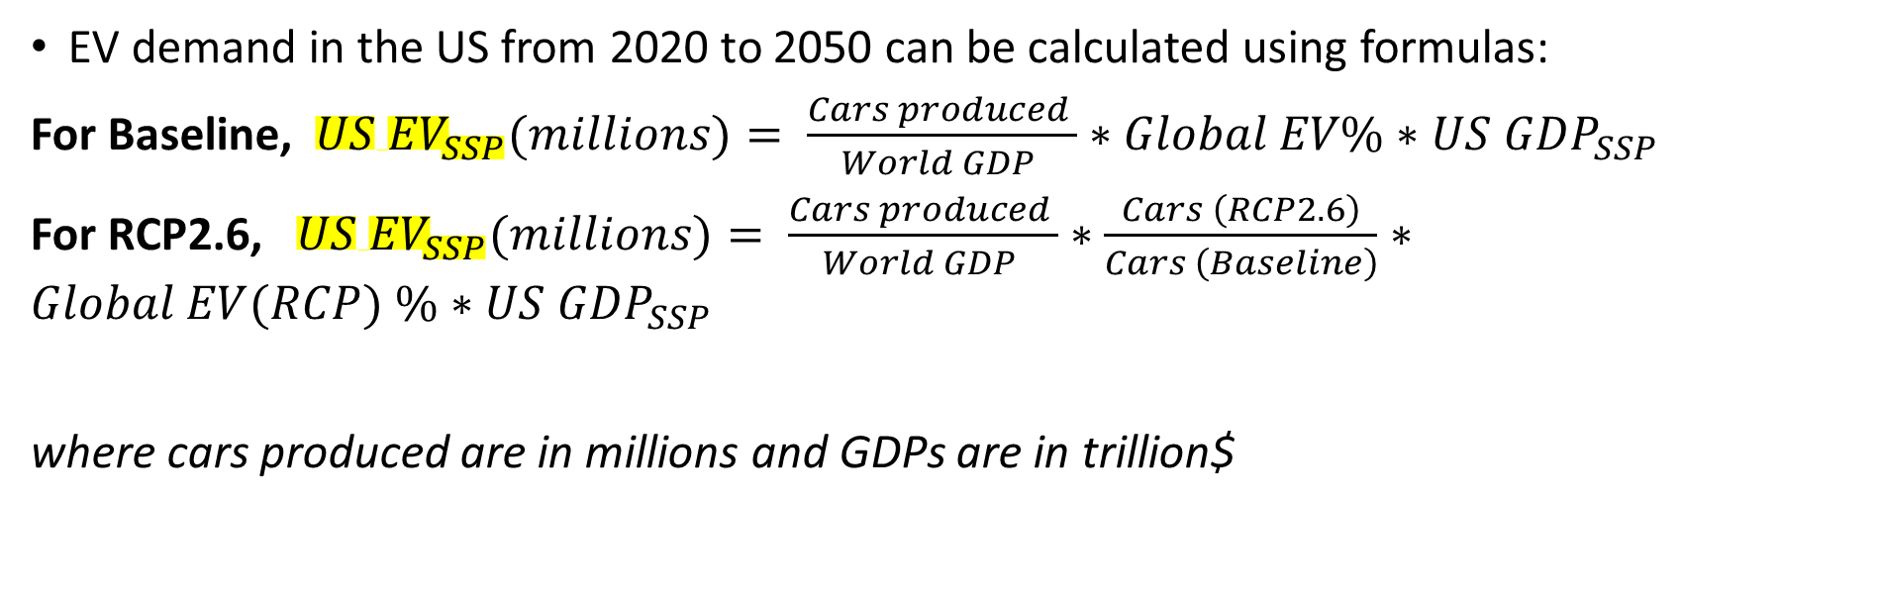
Future EV Demand by SSP and RCP
EV demand in the US from 2020 to 2050 can be calculated using formulas:
For Baseline, ${US EV}_{SSP}(millions)= \frac{Cars produced }{World GDP }∗Global EV\%∗{US GDP}_{SSP}$
For RCP2.6, ${US EV}_{SSP}(millions)= \frac{Cars produced }{World GDP }∗\frac{Cars \left(RCP2.6\right)}{Cars \left(Baseline\right)}∗Global EV(RCP) \%∗{US GDP}_{SSP}$
where cars produced are in millions and GDPs are in trillion$
Initial Research and Analysis
on
Electrochemical Graphitization

Slide 28
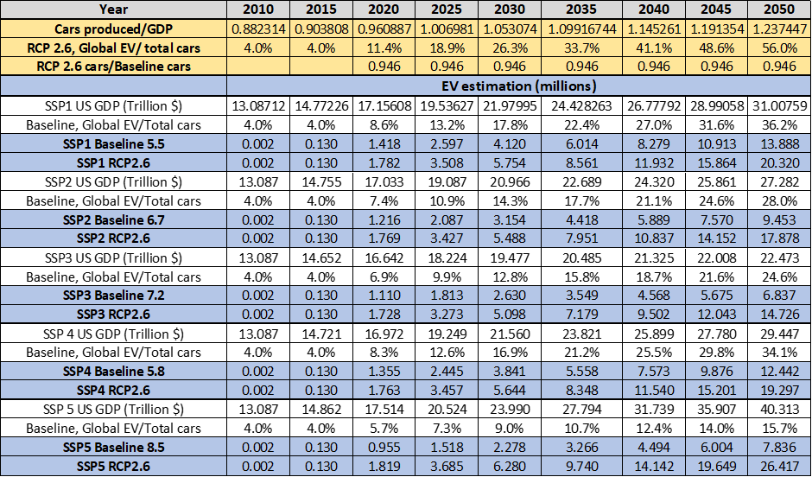
EV demand in millions of units by SSP and by RCP

Slide 29
EV Sales: Impact of RCP 2.6 vs baseline for SSP2

Slide 30
EV Sales: SSP and RCP impact for SSP5

Slide 31
Note that SSP5 with RCP spans most of the initial forecasts

Slide 32
EV battery types and composition
Batteries used in EV range from NCA (Nickel-Cobalt-Aluminium) to different configurations of NMC (Nickel-Manganese-Cobalt).
Battery technology can be seen growing towards more Nickel and lesser Cobalt configurations, i.e from NMC111
Assuming an average battery capacity of 64kWh to be used in an EV in future (providing ~270miles range), battery metal content (in kg) for each type of battery is calculated:
Initial Research and Analysis
on
Electrochemical Graphitization
Reference: https://publications.jrc.ec.europa.eu/repository/bitstream/JRC112285/jrc112285_cobalt.pdf
https://www.crugroup.com/knowledge-and-insights/insights/2018/nmc-811-adoption-in-the-auto-sector-hits-a-speed-bump/
http://publications.lib.chalmers.se/records/fulltext/230991/local_230991.pdf

Slide 33
Battery mix projections by different agencies

Slide 34
Cobalt per EV is expected to decrease
given technology shifts
Year | 2020 | 2025 | 2030 | 2035 | 2040 | 2045 | 2050
Cobalt per battery (kg) | 8.59 | 7.635 | 6.68 | 5.725 | 4.77 | 3.815 | 2.86

Slide 35
US GDP/ Global GDP | 0.170 | 0.158 | 0.148 | 0.139 | 0.132 | 0.125 | 0.119
Year | 2020 | 2025 | 2030 | 2035 | 2040 | 2045 | 2050
low supply (k.tons) | 9.875 | 15.494 | 15.280 | 18.918 | 21.620 | 24.323 | 27.025
high supply (k.tons) | 13.049 | 18.844 | 19.198 | 23.222 | 26.296 | 29.371 | 32.445
Average supply (k.tons) | 11.462 | 17.169 | 17.239 | 21.070 | 23.958 | 26.847 | 29.735

Slide 36
Insufficient Cobalt supply for few of the SSP scenarios

Slide 37
Insufficient Cobalt for all the scenarios

Slide 38
Insufficient Ni after 2035 for few of the scenarios

Slide 39
Insufficient Ni for most of the scenarios starting in 2020

Slide 40
Summary of results for Battery materials
With no RCP forcing, Co is an issue for just a few scenarios
With an RCP of 2.6, Co supply is a problem for most scenarios
With no RCP forcing, Ni not much of an issue until 2035
With an RCP of 2.6, Ni supply is a problem for most scenarios
Our projections do not show supply and demand mismatches for Manganese or Lithium based on data available at this time

Slide 41
Future Plans
We are eager to work on interesting problems
Our student team supported by staff, deliver novel solutions
You get to mentor and experience committed Purdue students
Our projects are funded by grants, gifts, contracts etc
Just call Steve to get started (dunlops@purdue.edu)

Slide 42
Thank you
Aiyer@purdue.edu
7654944514

